Slide 1
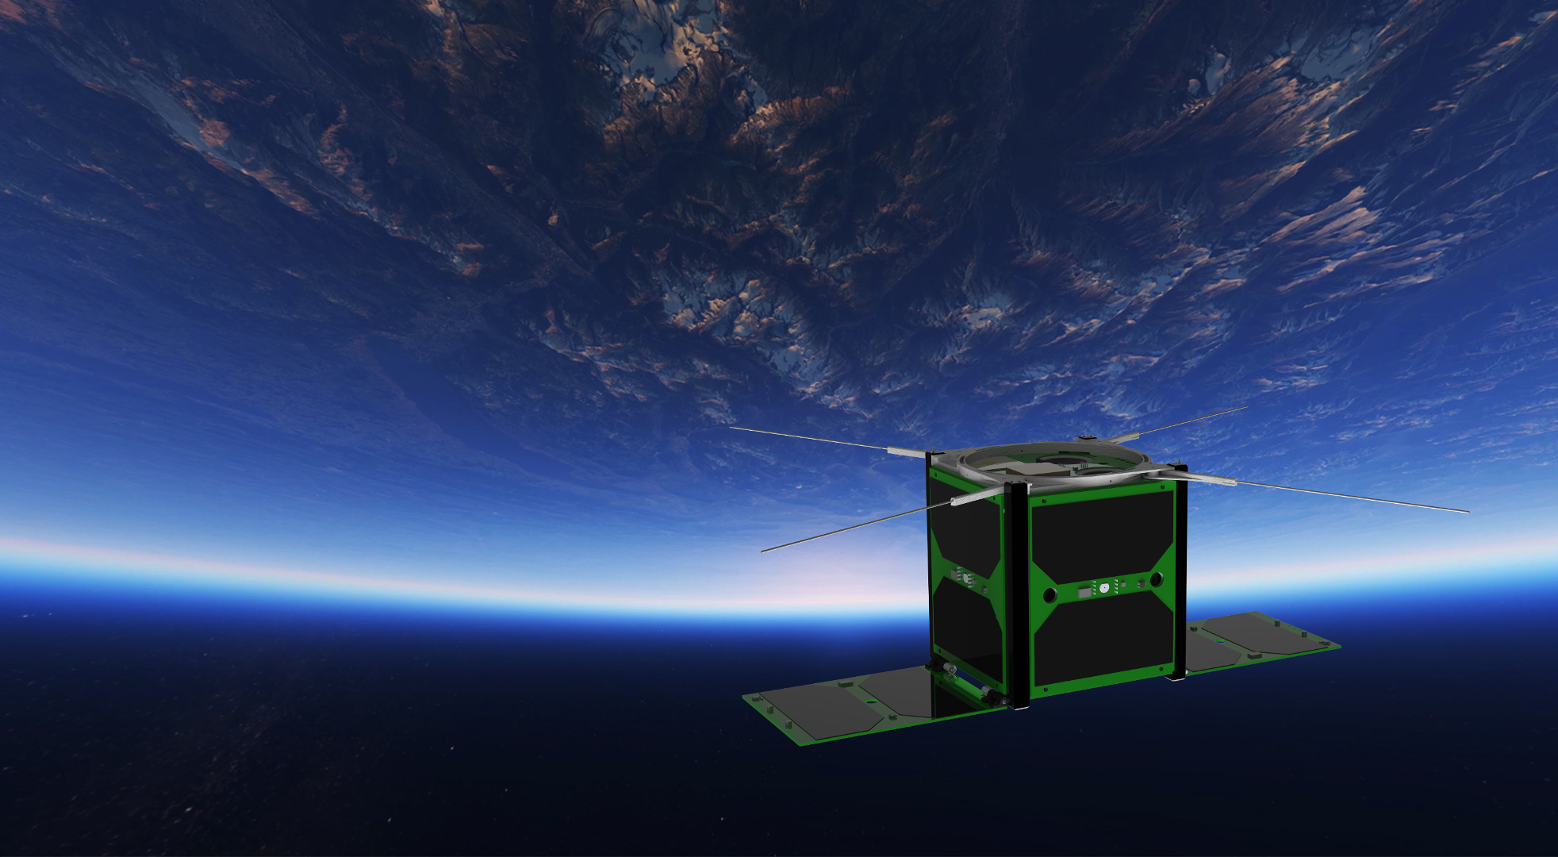
Space danger
satellite.taltech.ee
rauno.gordon@taltech.ee

Slide 2
satellite.taltech.ee
Requirements to get to a rocket – vibration, thermal-vacuum
Space environment – objects, debris, relative speeds
Surface dangers – atomic oxygen
Radiation from the sun – Earth magnetic field, solar activity
Galactic radiation – particles, ions
Shielding – aluminum, water/hydrogen
Dust shielding – lighter + conductive, spreading
Whiskers, conformal coating, cold welding
Large scale shielding – atmosphere, magnetic fields
Effects on humans

Slide 3
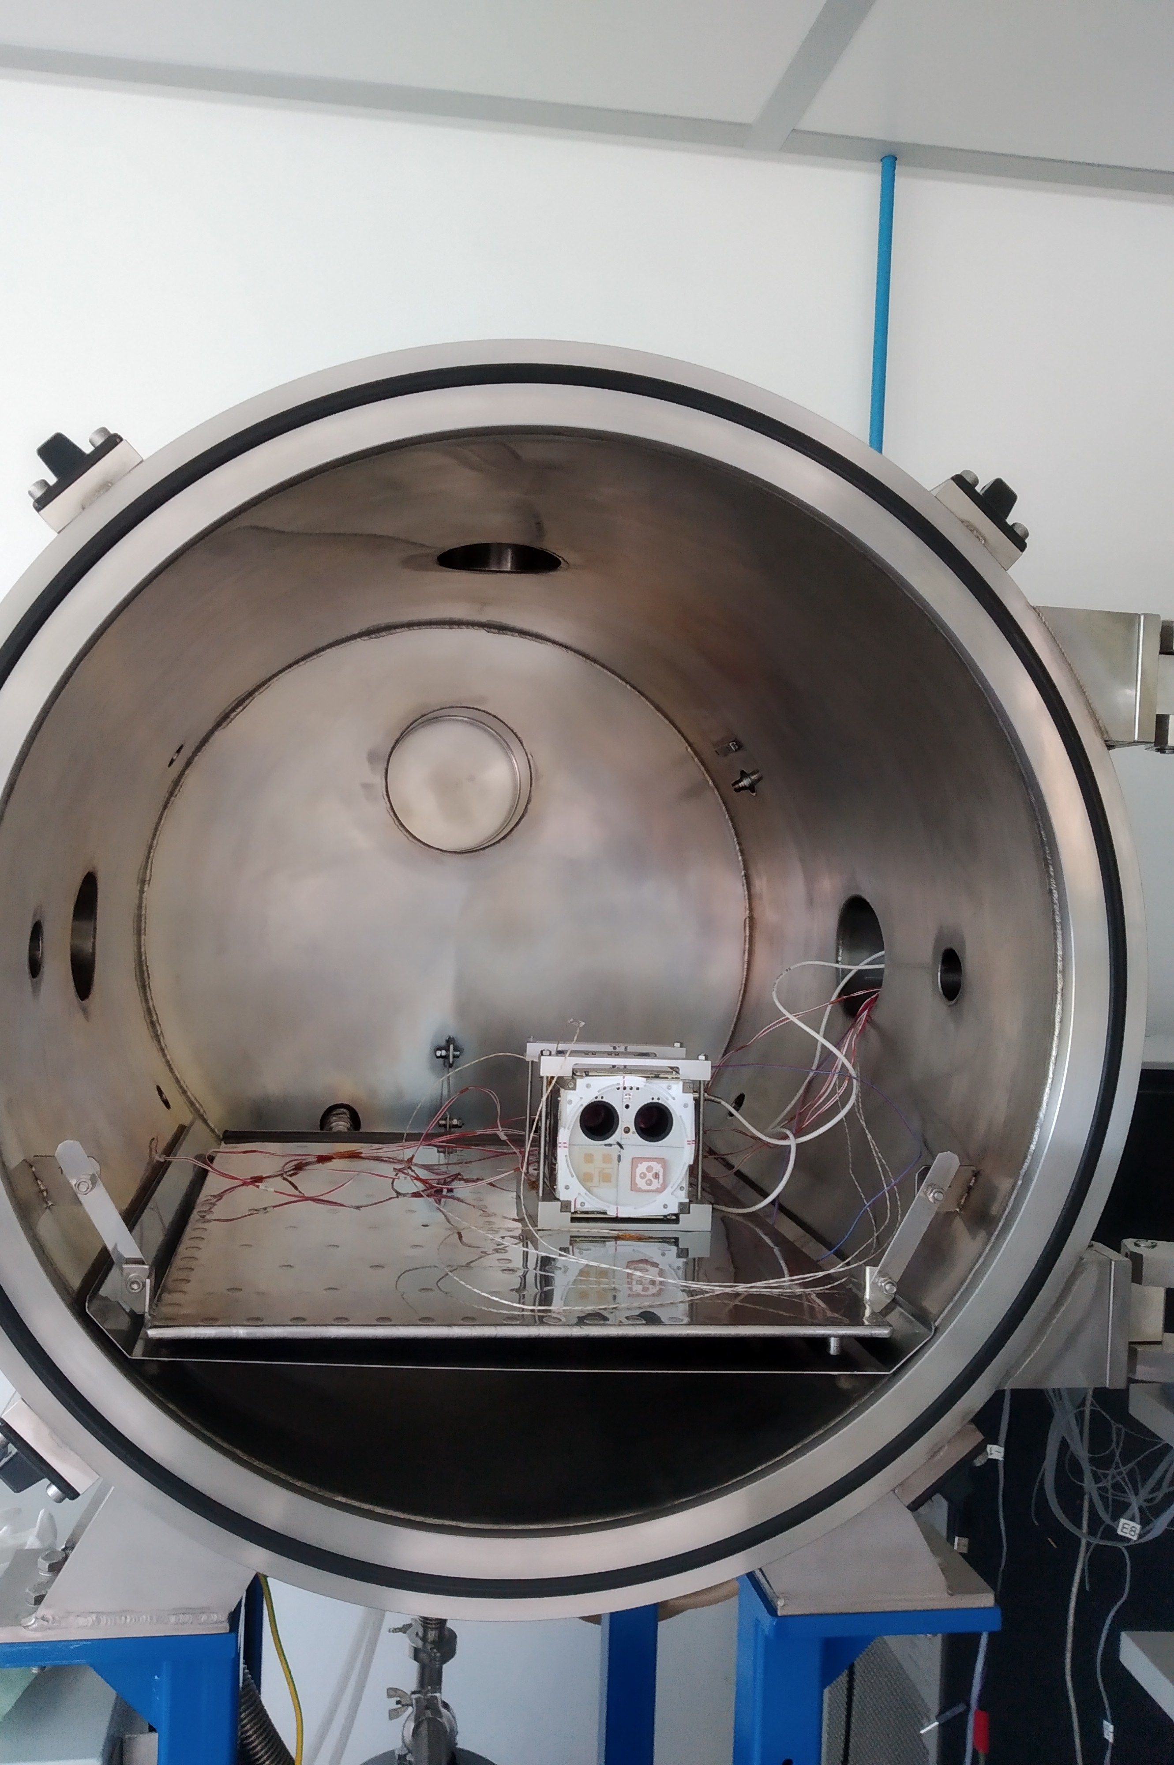
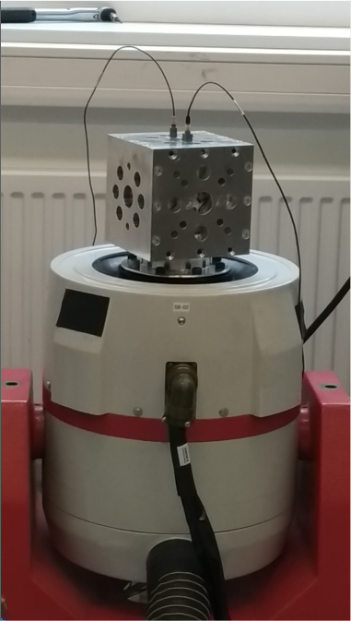
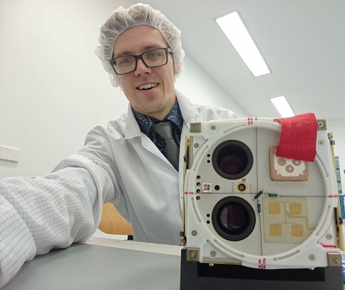
Koit satellite testing in Tõravere 05.2019
Satellite integration in Berlin

Slide 4
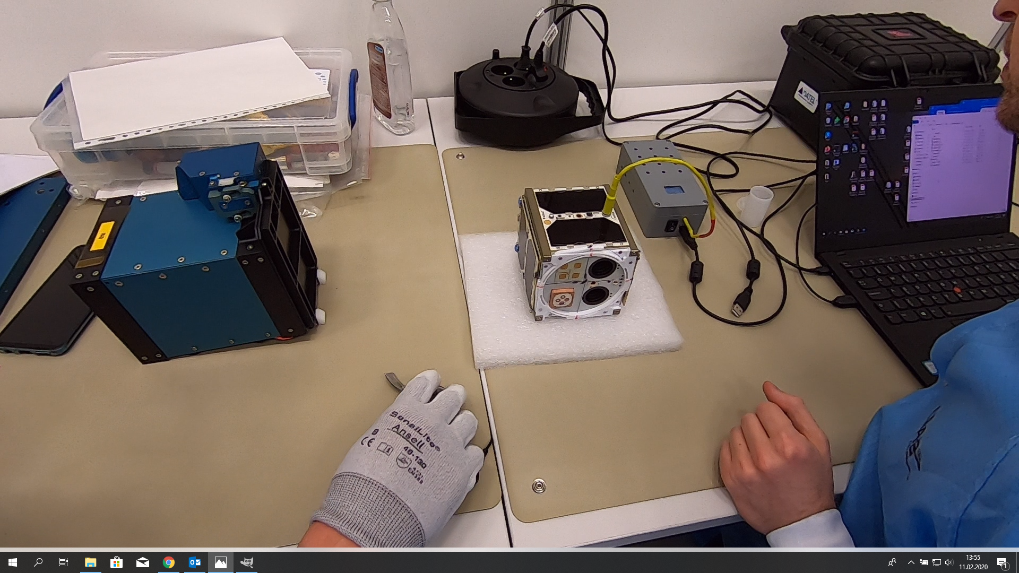
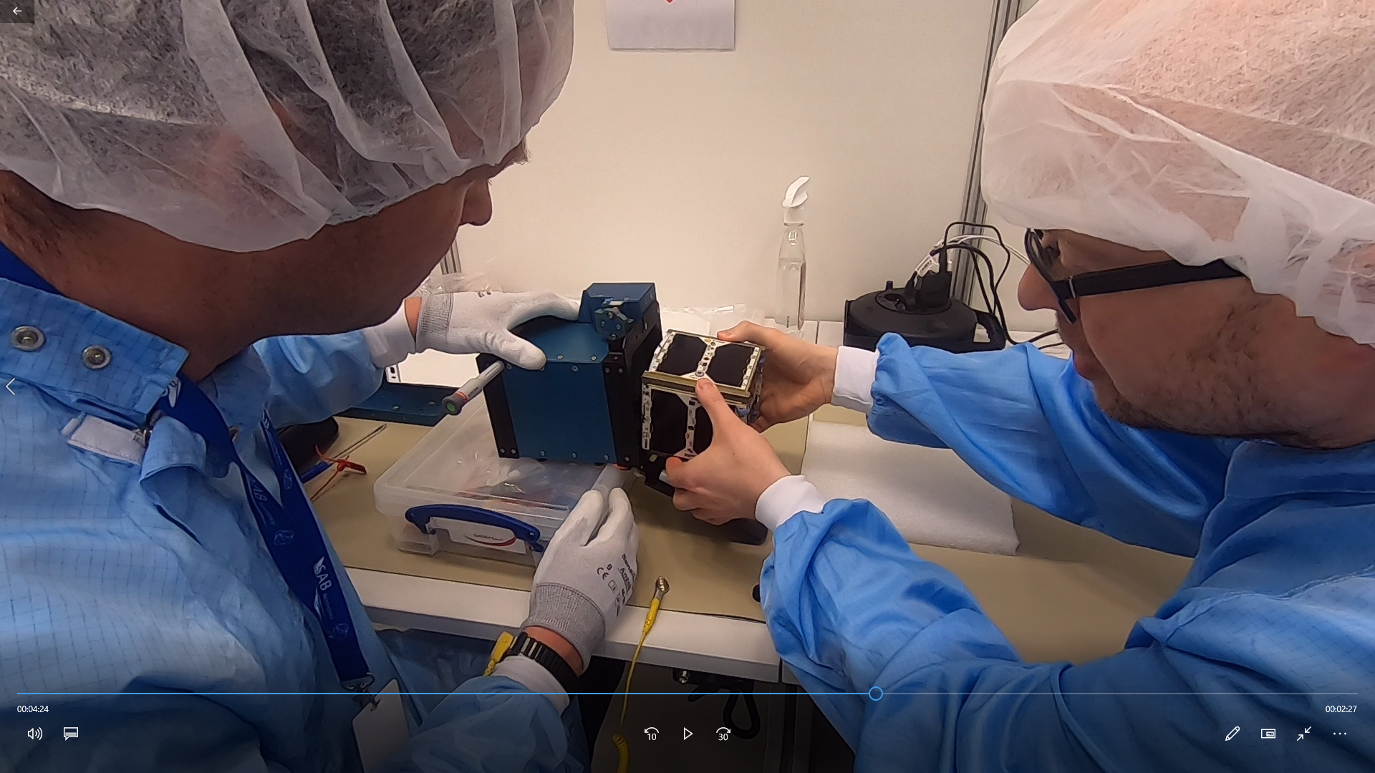
Hämarik satellite integration in Brno

Slide 5
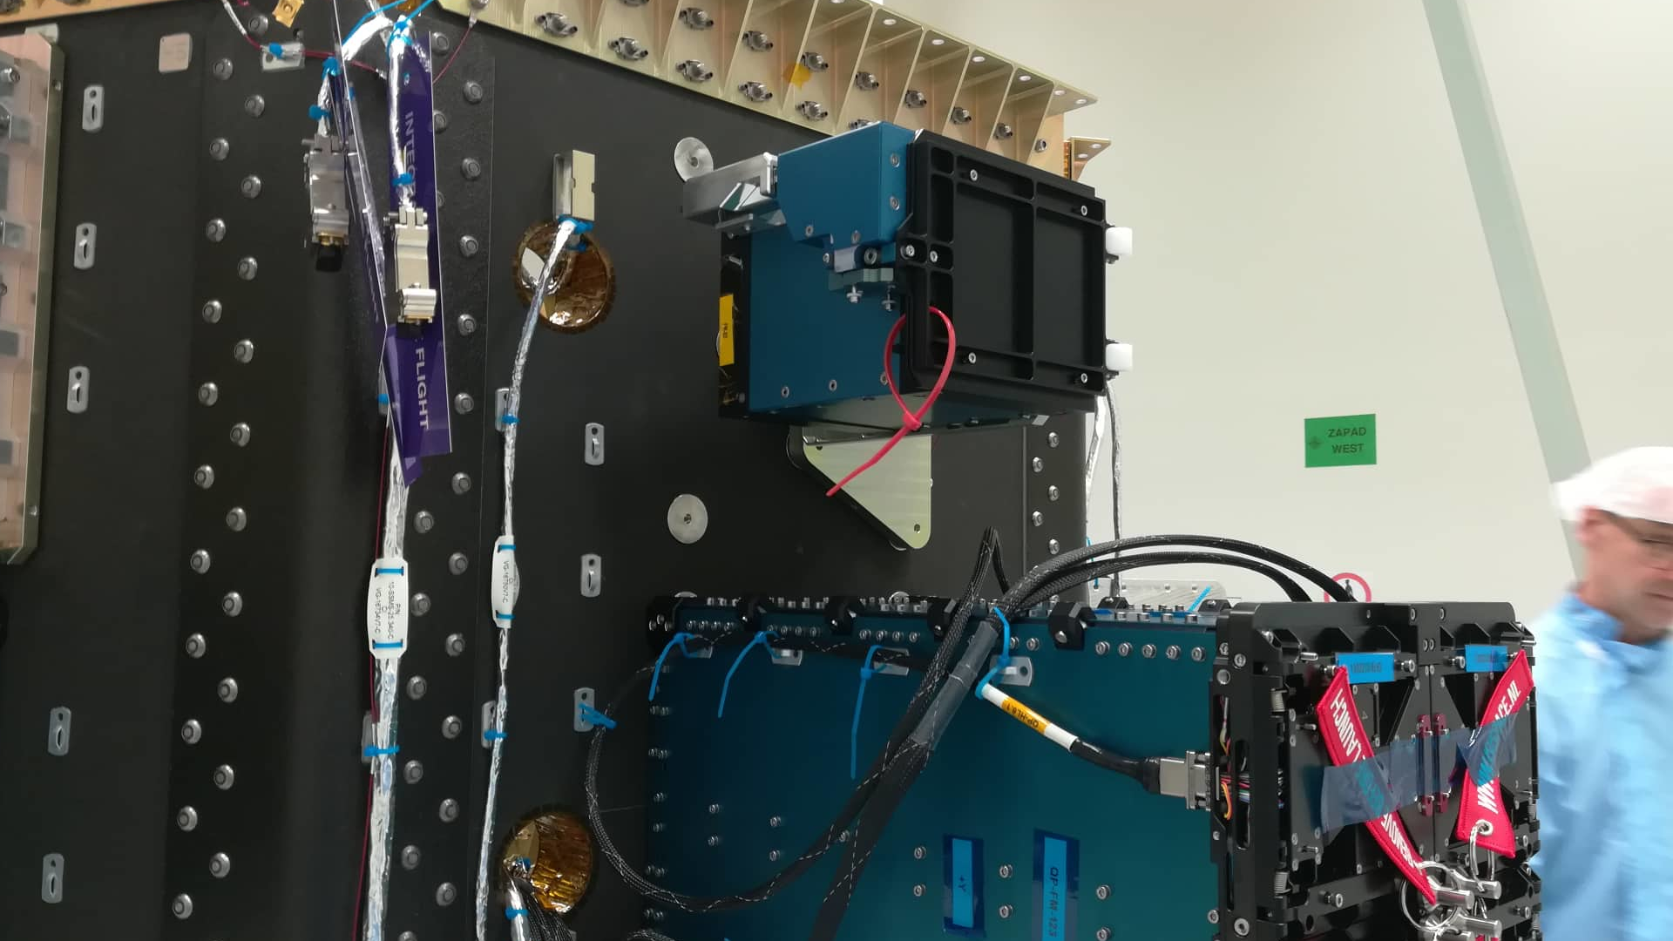

Slide 6
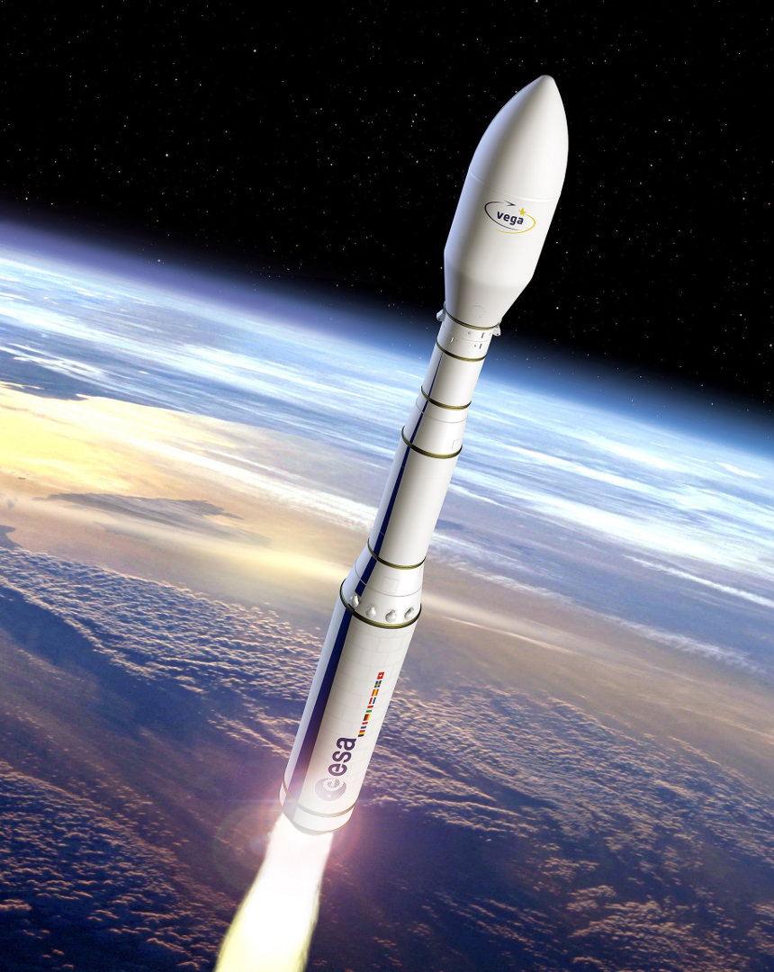
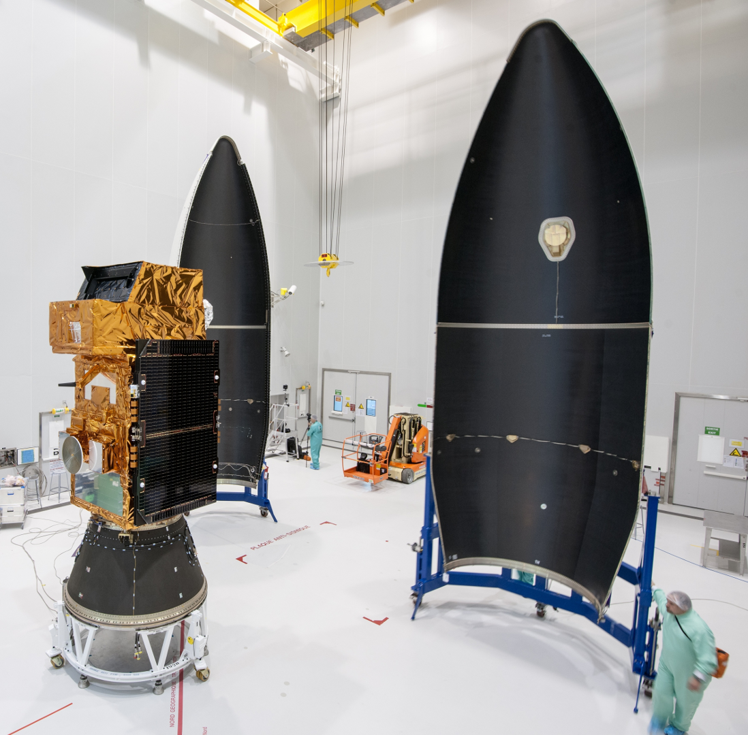

Slide 7
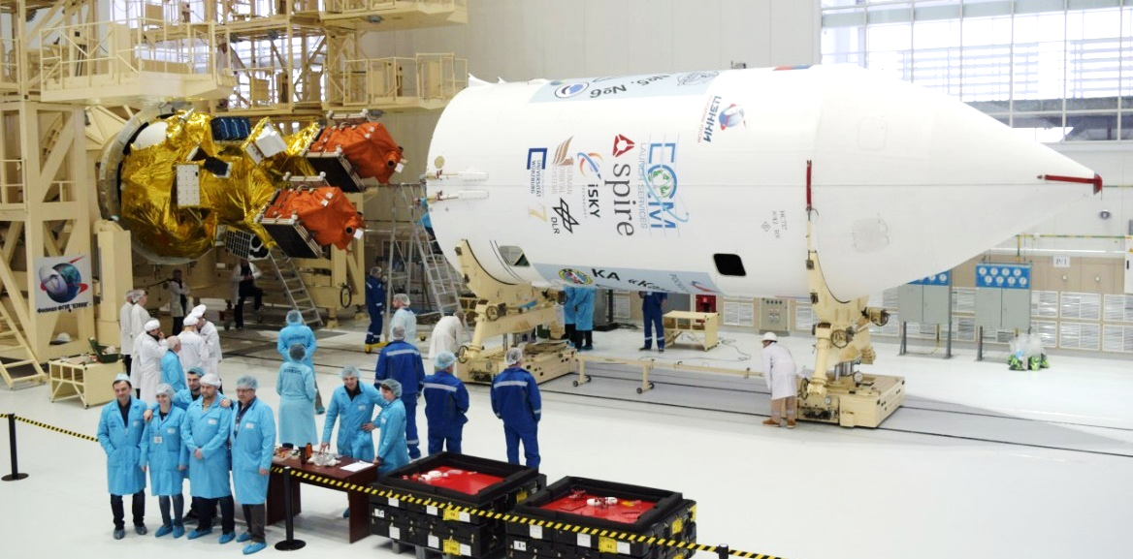

Slide 8
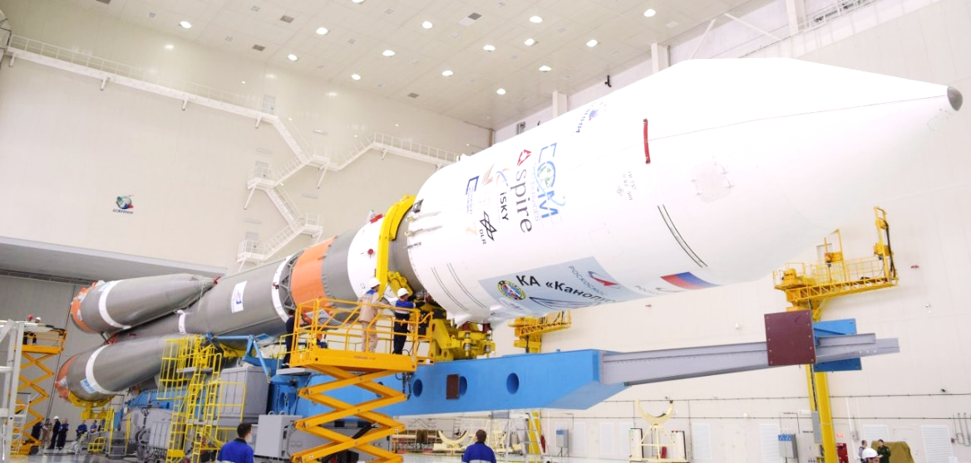

Slide 9
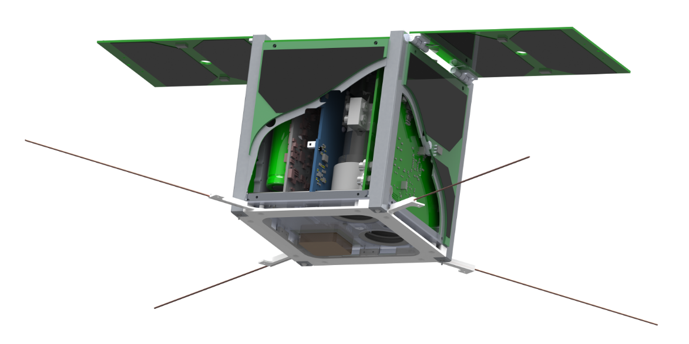
satellite.taltech.ee
solar panels
main computer
radio
power system
cameras
attitude control

Slide 11
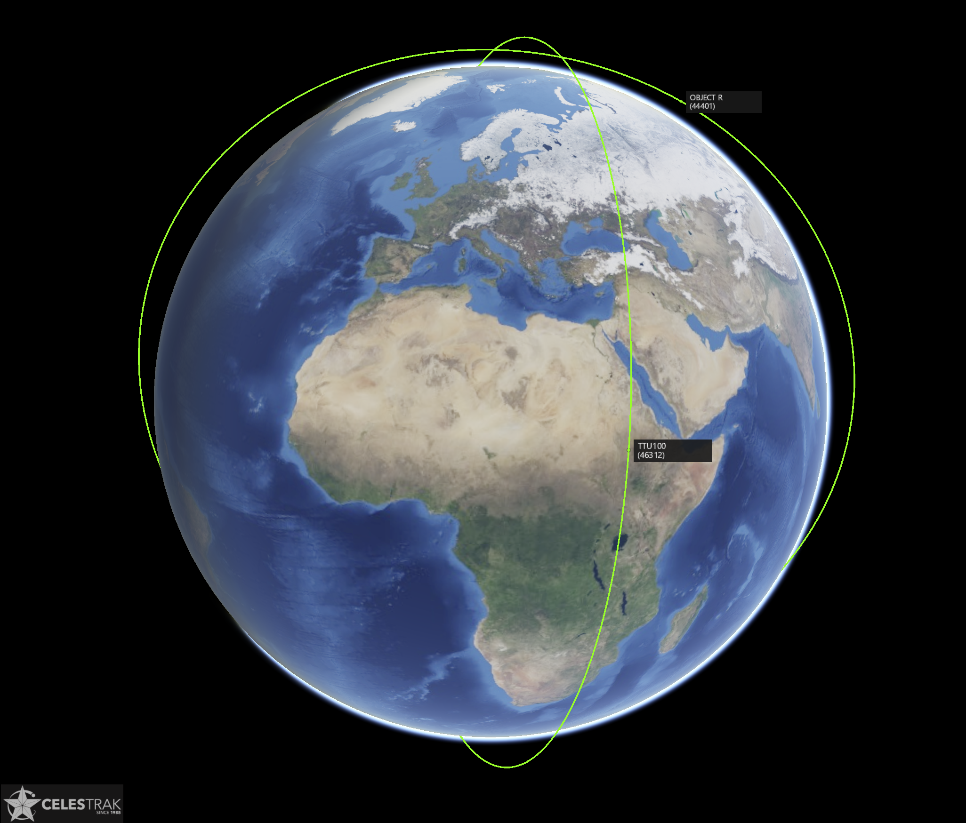
Koit
(Dawn, TTU101)
Launch: 5. July 2019
Roscosmos Soyuz
530 km, SSO
LTAN: 15:05
Object: 2019-038R
Hämarik
(Dusk, TTU100)
Launch: 3.Sept 2020
Arianespace Vega
550 km, SSO
LTAN: 22:30
Object: 2020-061AS
rauno.gordon@ttu.ee

Slide 12
https://celestrak.com/
satellite.taltech.ee
rauno.gordon@taltech.ee

Slide 13
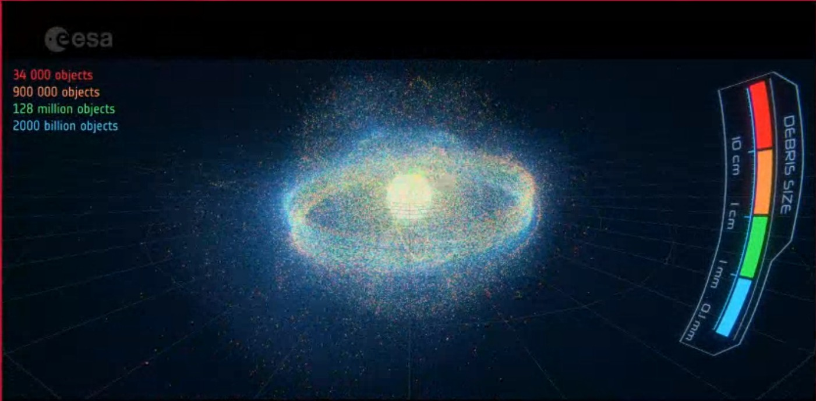
Kosmoseprügi

Slide 14
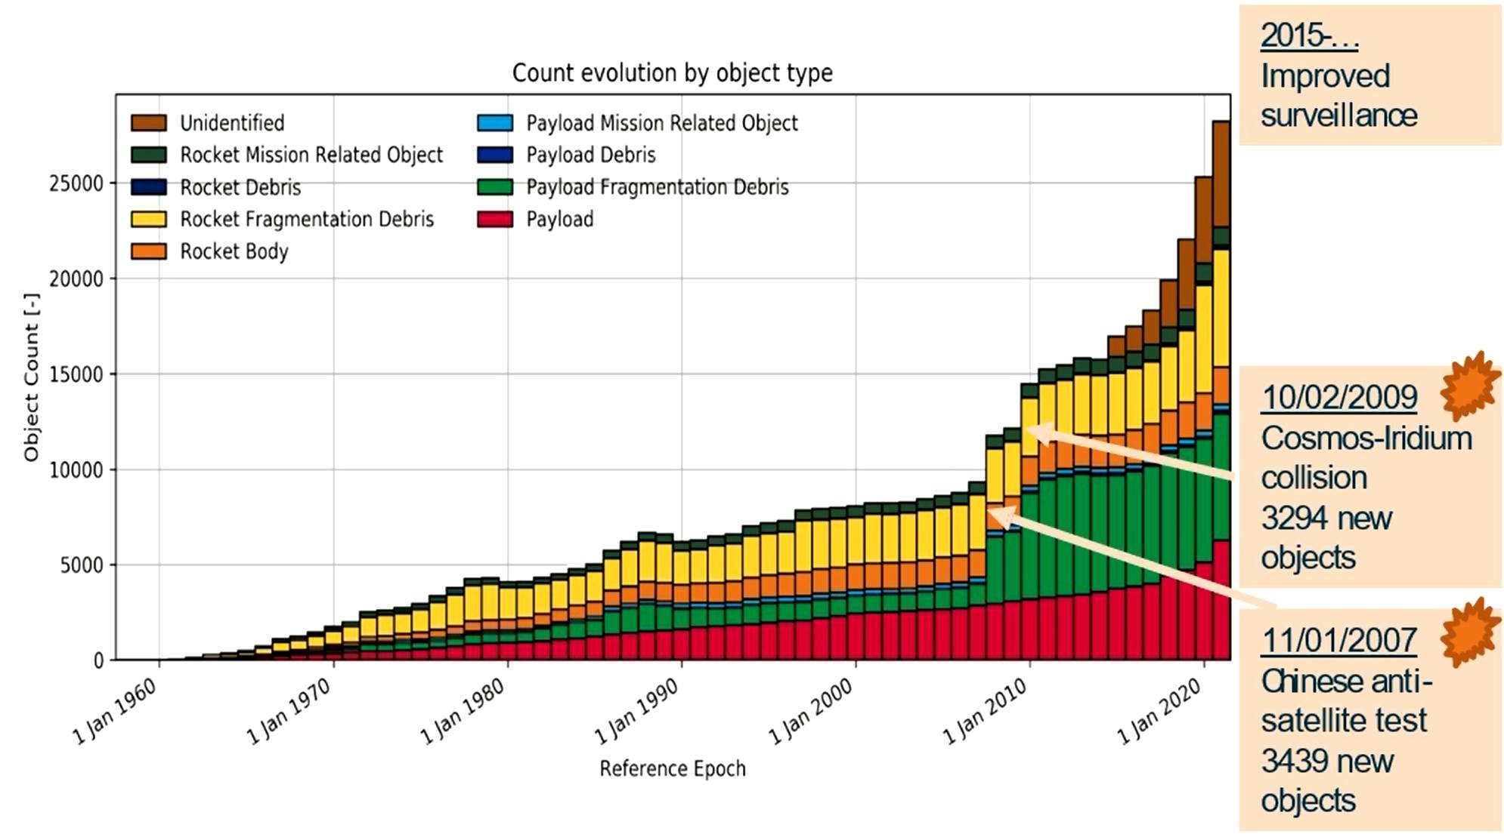
Space debris

Slide 15
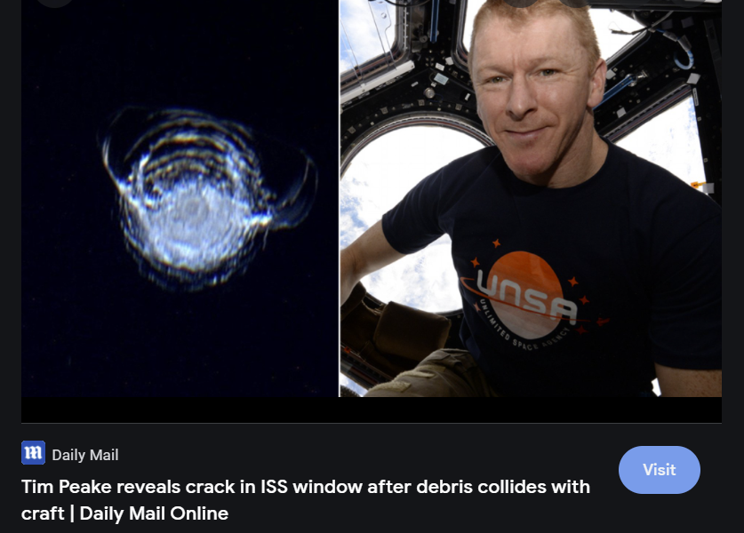
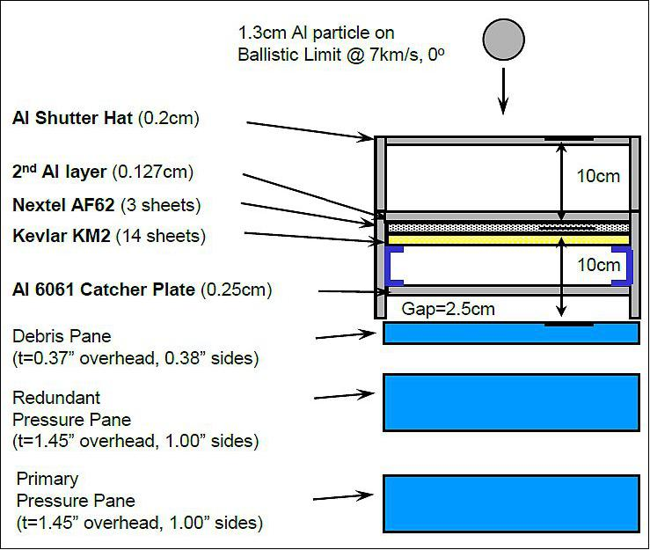
Space debris
satelliit.taltech.ee
rauno.gordon@taltech.ee

Slide 16
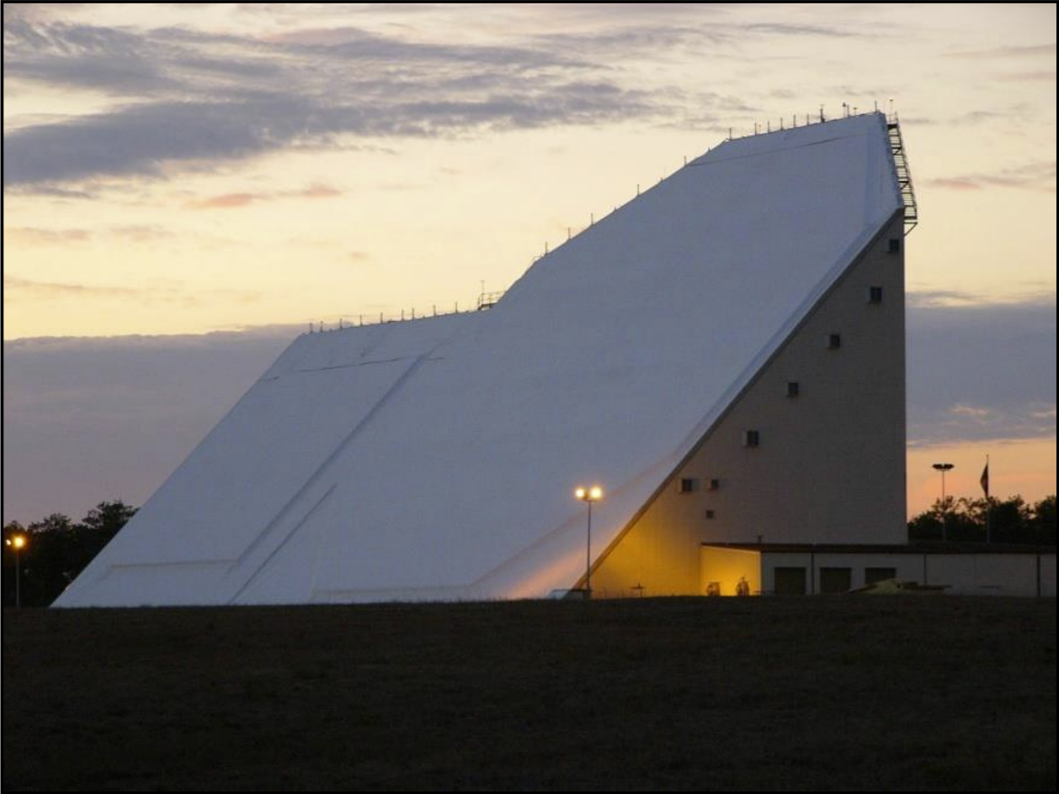
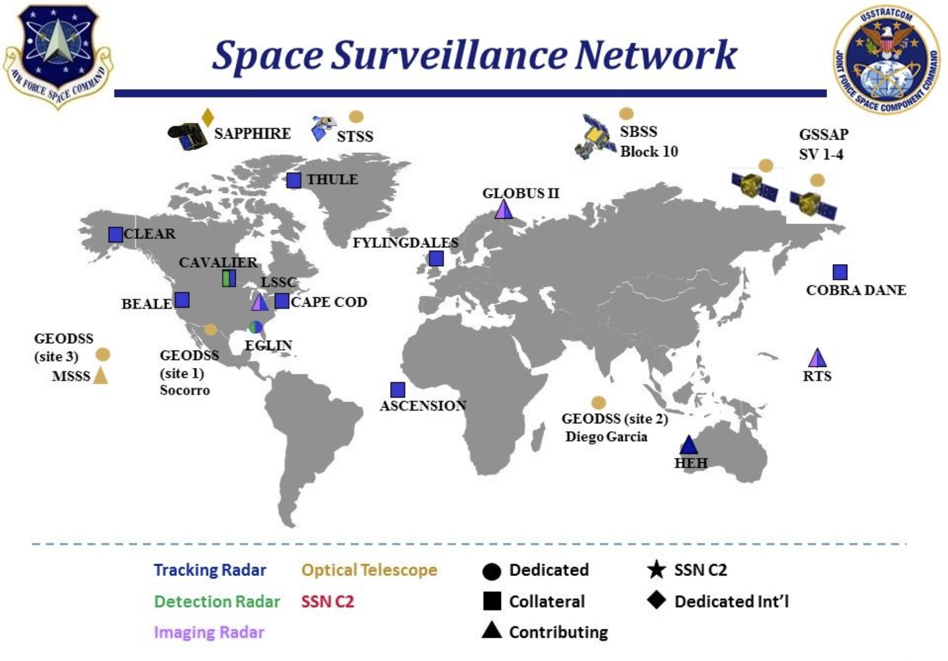
Tracking space debris
Phased array space surveillance radar at Eglin, Florida
satelliit.taltech.ee
rauno.gordon@taltech.ee

Slide 17
satellite.taltech.ee
Requirements to get to a rocket – vibration, thermal-vacuum
Space environment – objects, debris, relative speeds
Surface dangers – atomic oxygen
Radiation from the sun – Earth magnetic field, solar activity
Galactic radiation – particles, ions
Shielding – aluminum, water/hydrogen
Dust shielding – lighter + conductive, spreading
Whiskers, conformal coating, cold welding
Large scale shielding – atmosphere, magnetic fields
Effects on humans
rauno.gordon@taltech.ee

Slide 18
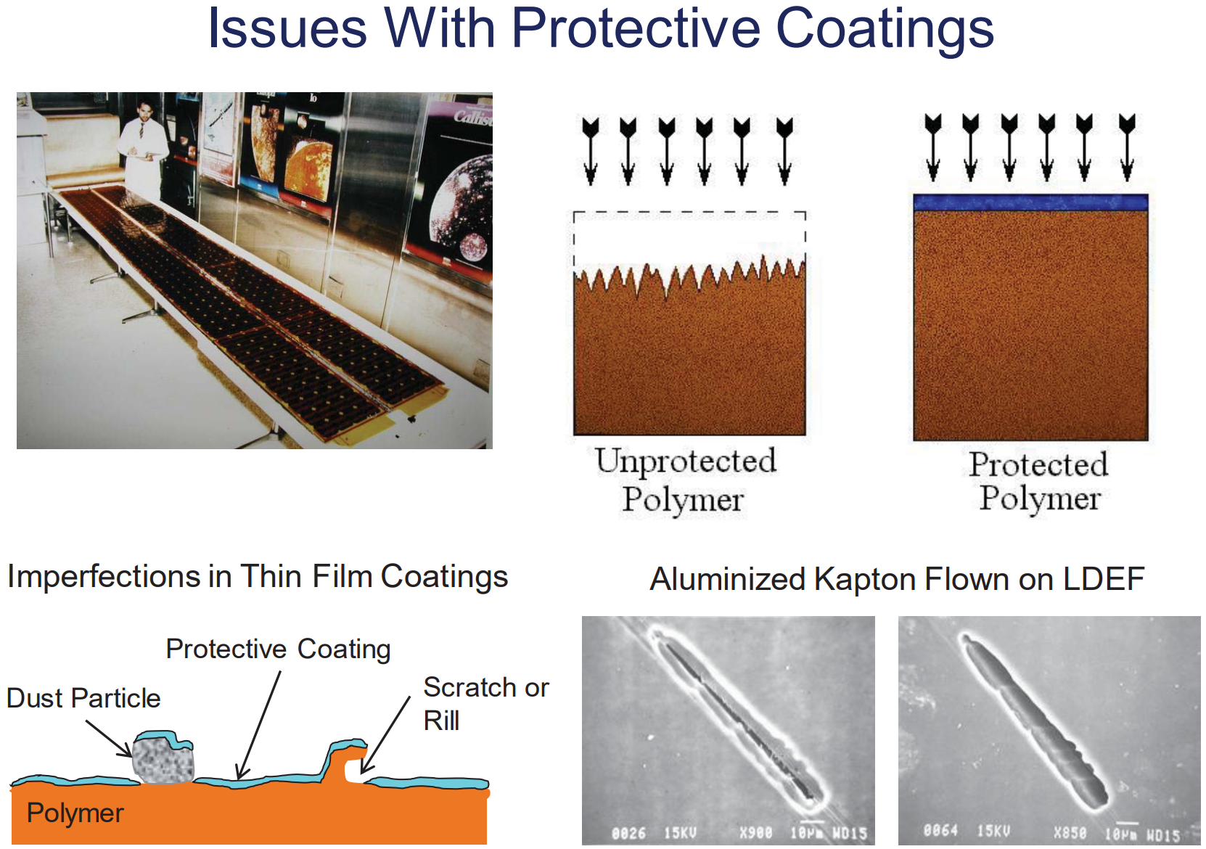
satellite.taltech.ee
Surface dangers – atomic oxygen
rauno.gordon@taltech.ee

Slide 19
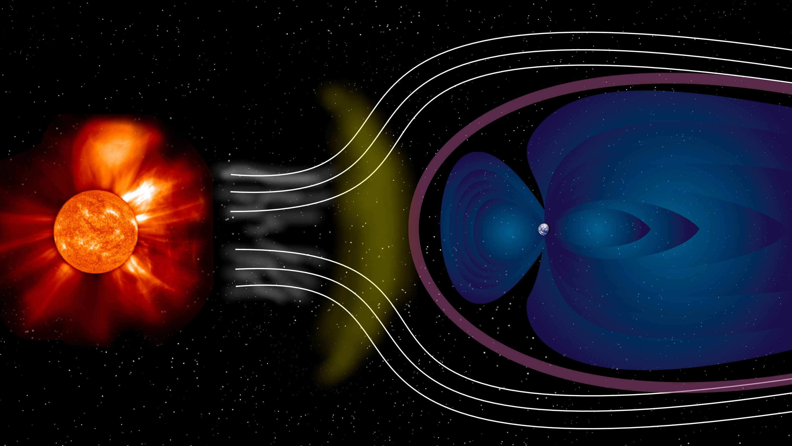
satellite.taltech.ee
rauno.gordon@taltech.ee

Slide 20
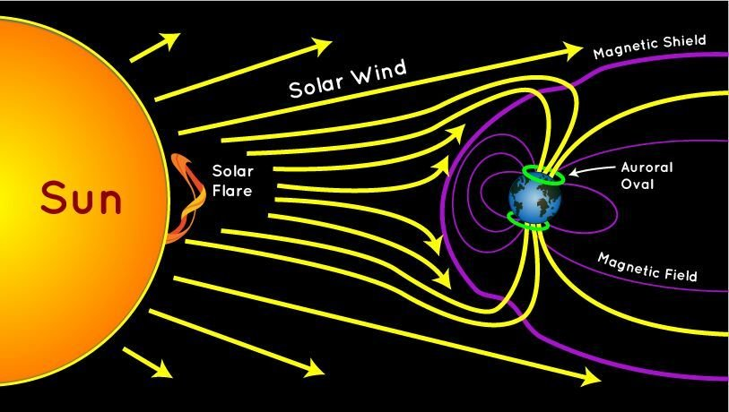
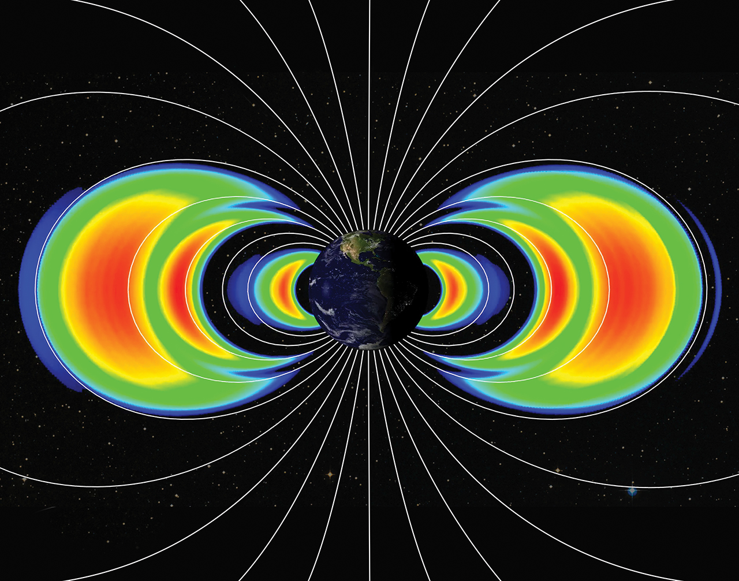
satellite.taltech.ee
rauno.gordon@taltech.ee

Slide 21
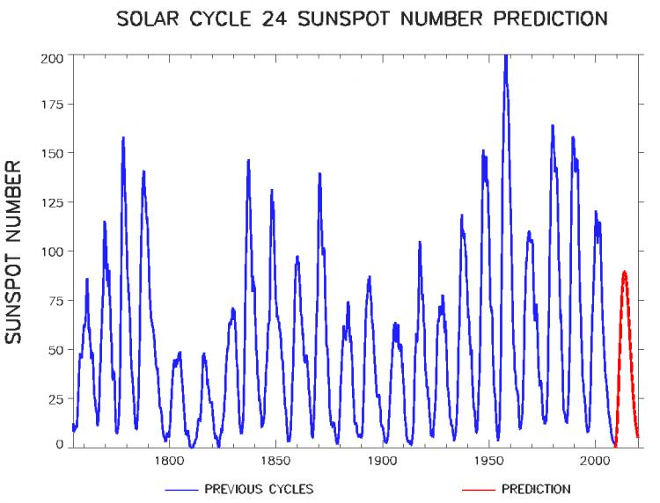
satellite.taltech.ee
rauno.gordon@taltech.ee

Slide 22
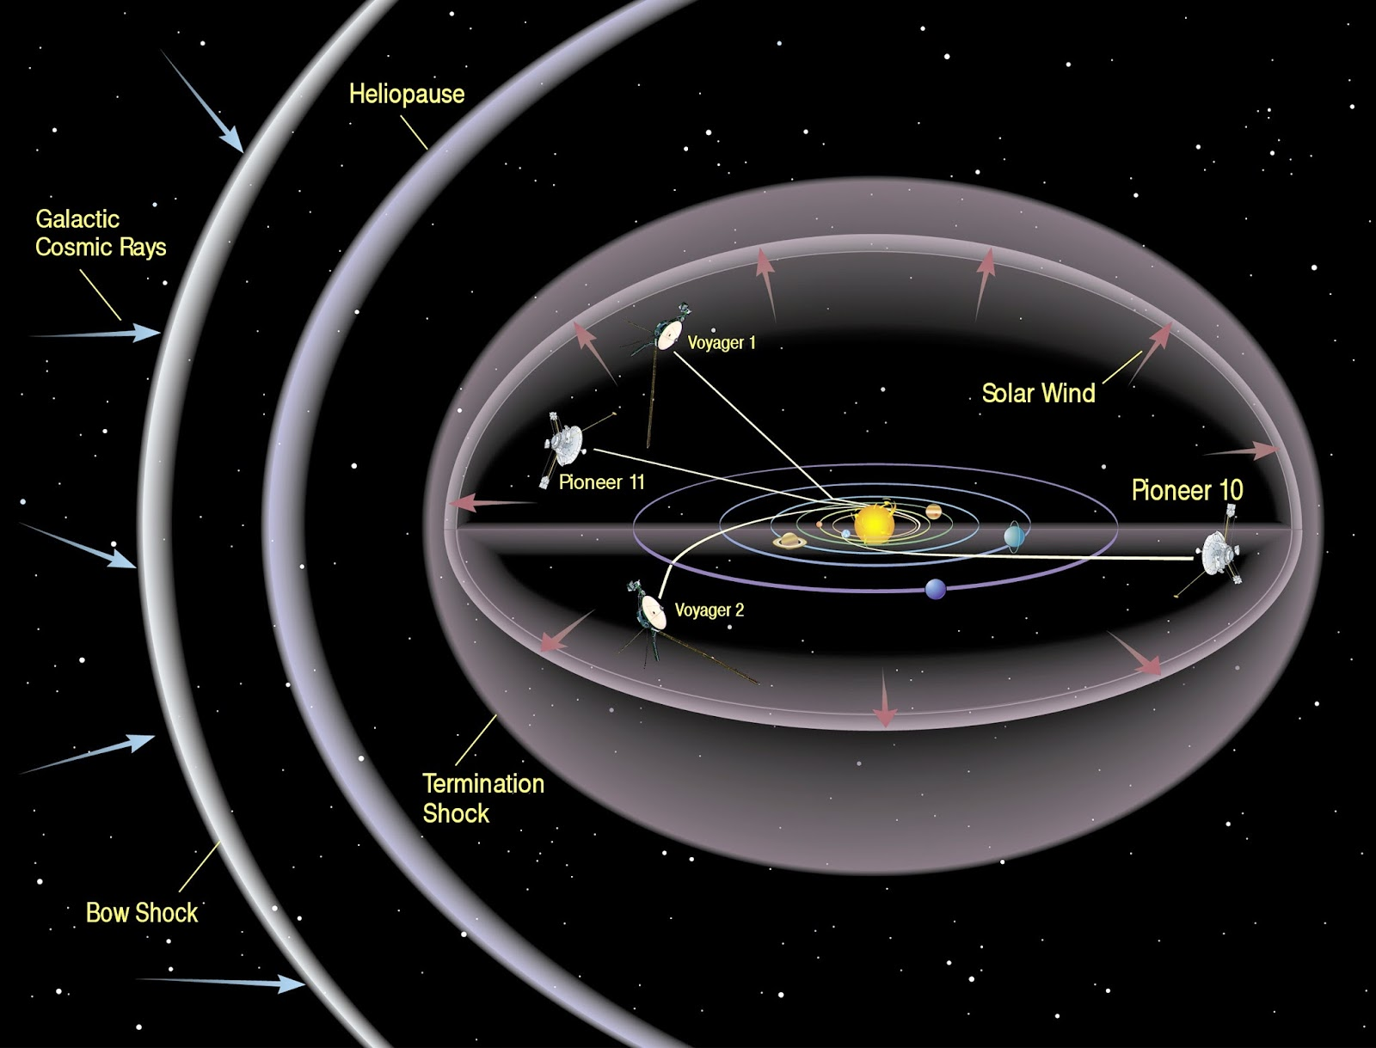
satellite.taltech.ee
rauno.gordon@taltech.ee

Slide 23
satellite.taltech.ee
Requirements to get to a rocket – vibration, thermal-vacuum
Space environment – objects, debris, relative speeds
Surface dangers – atomic oxygen
Radiation from the sun – Earth magnetic field, solar activity
Galactic radiation – particles, ions
Shielding – aluminum, water/hydrogen
Dust shielding – lighter + conductive, spreading
Whiskers, conformal coating, cold welding
Large scale shielding – atmosphere, magnetic fields
Effects on humans
rauno.gordon@taltech.ee

Slide 24
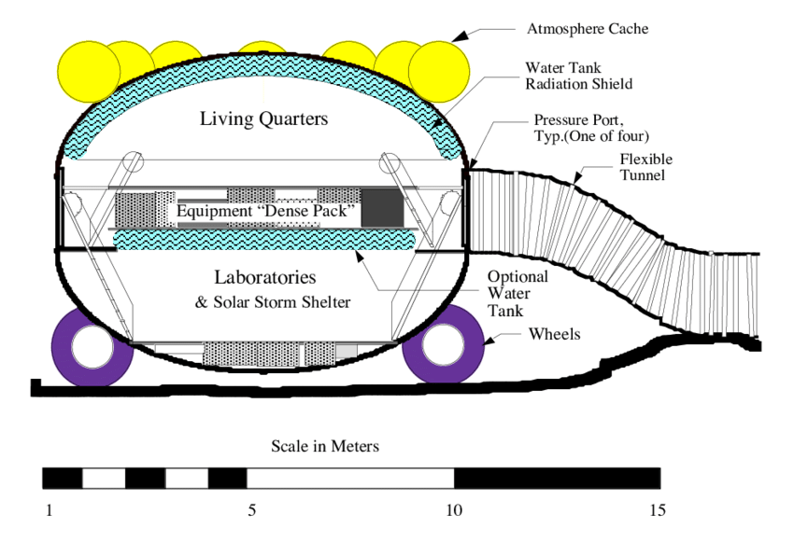
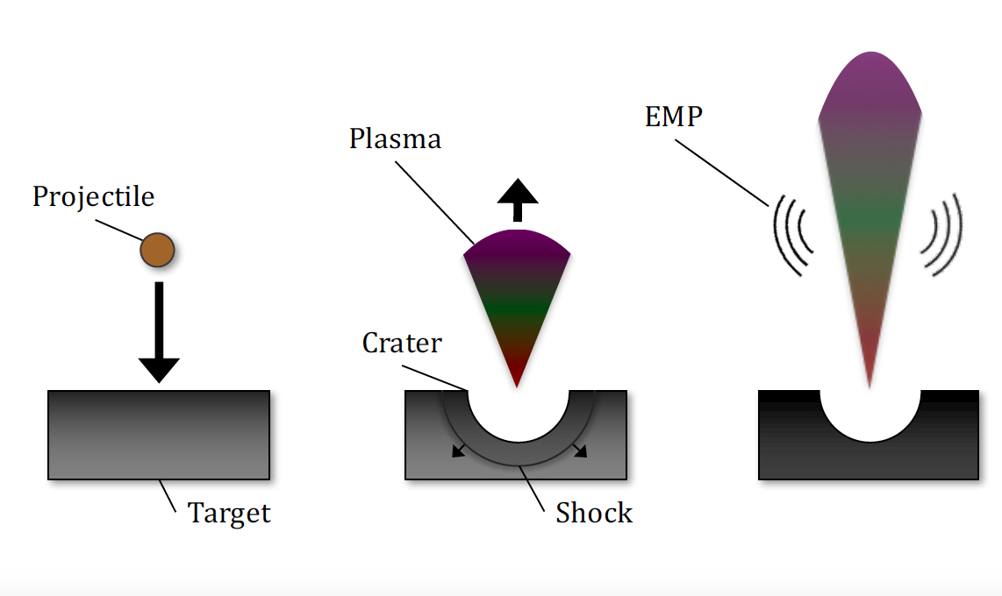
Shielding – aluminum, water/hydrogen
satellite.taltech.ee
rauno.gordon@taltech.ee

Slide 25
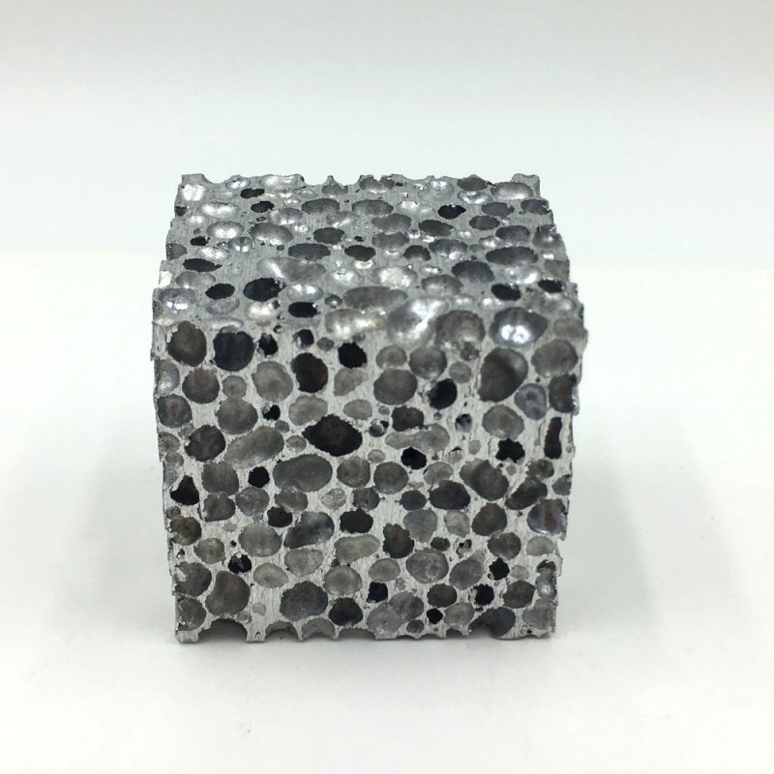
Dust shielding – lighter + conductive, spreading
satellite.taltech.ee
rauno.gordon@taltech.ee

Slide 26
satellite.taltech.ee
Requirements to get to a rocket – vibration, thermal-vacuum
Space environment – objects, debris, relative speeds
Surface dangers – atomic oxygen
Radiation from the sun – Earth magnetic field, solar activity
Galactic radiation – particles, ions
Shielding – aluminum, water/hydrogen
Dust shielding – lighter + conductive, spreading
Whiskers, conformal coating, cold welding
Large scale shielding – atmosphere, magnetic fields
Effects on humans
rauno.gordon@taltech.ee

Slide 27
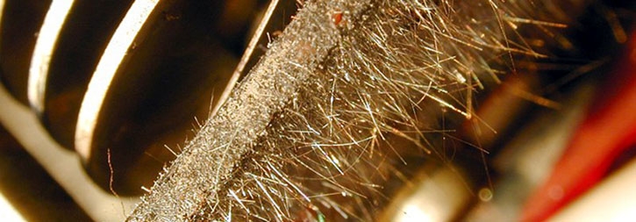
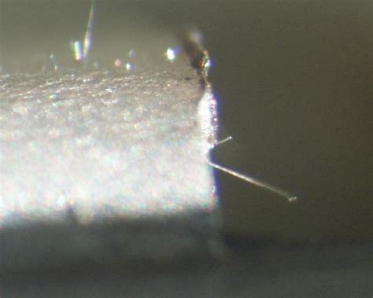
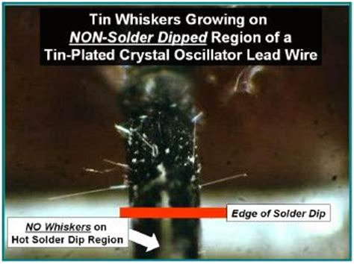
Whiskers, conformal coating, cold welding
satellite.taltech.ee
rauno.gordon@taltech.ee

Slide 28
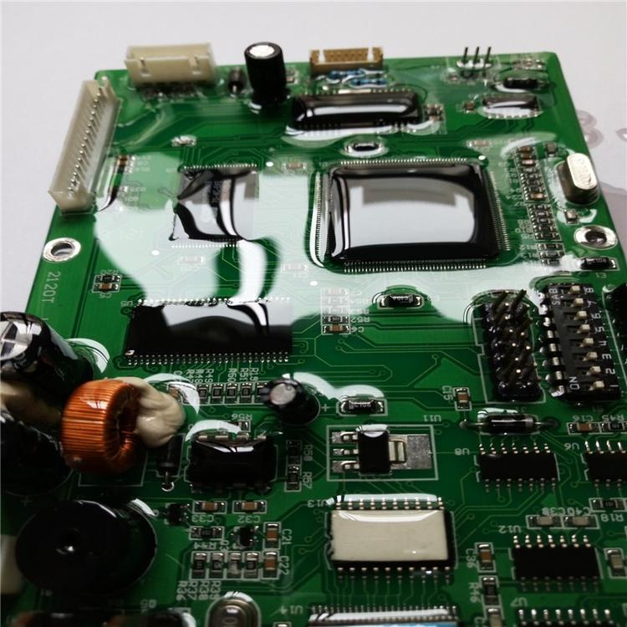
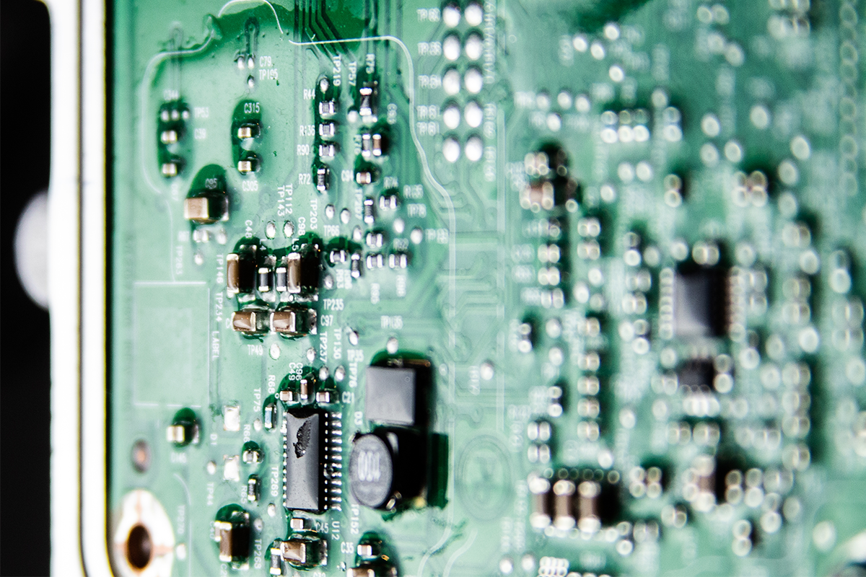
Whiskers, conformal coating, cold welding
satellite.taltech.ee
rauno.gordon@taltech.ee

Slide 29
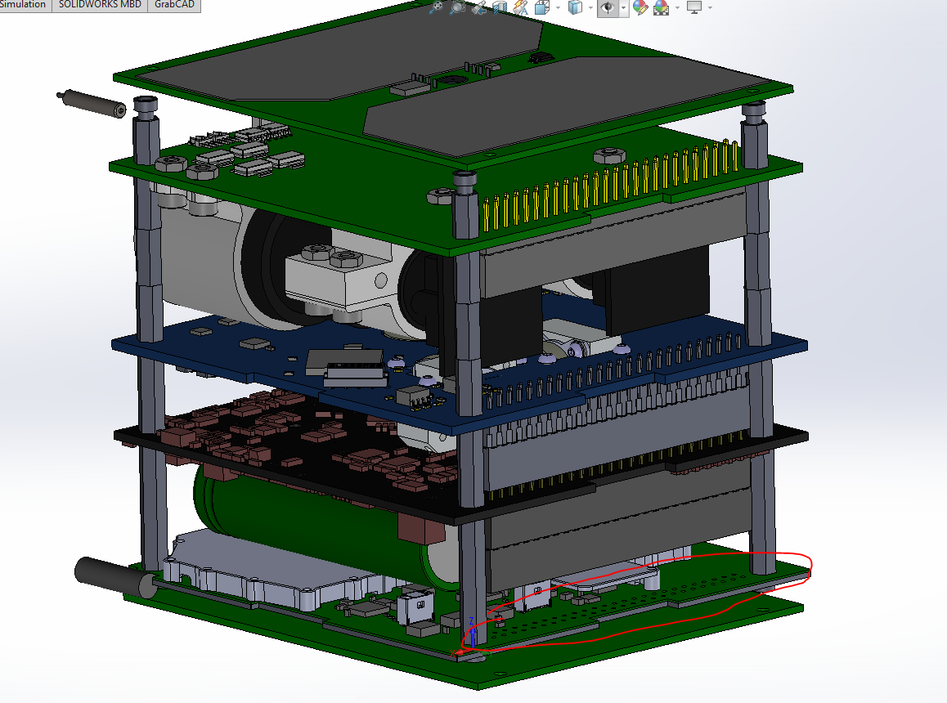
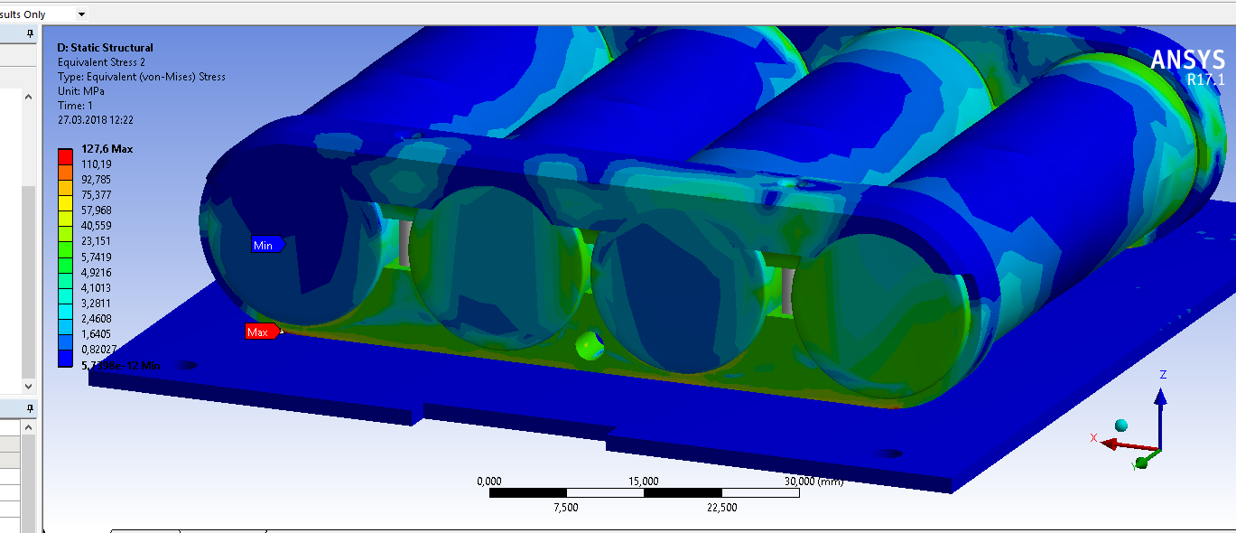
Mechanics - integration

Slide 30
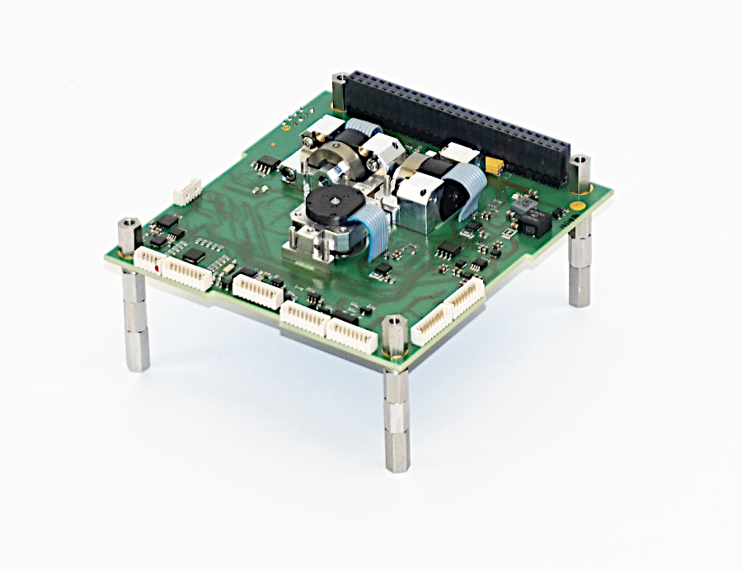
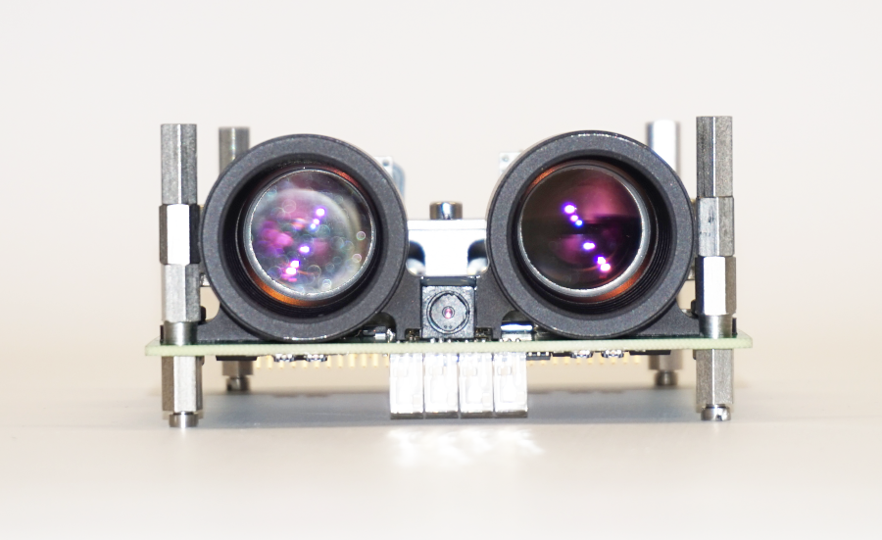
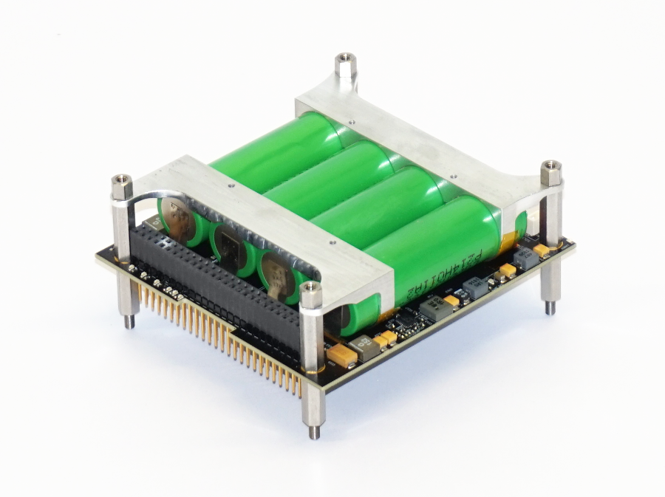
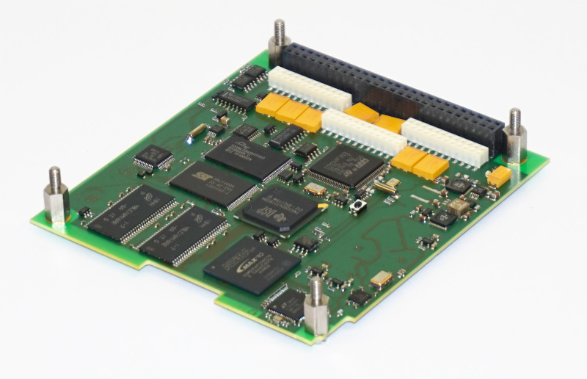
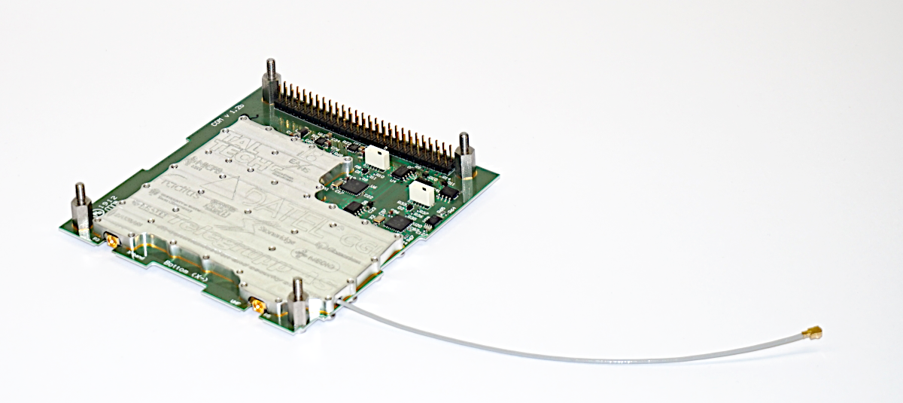
satellite.taltech.ee
RGB and NIR cameras
attitude control
power system
main computer
UHF & X-band radio

Slide 31
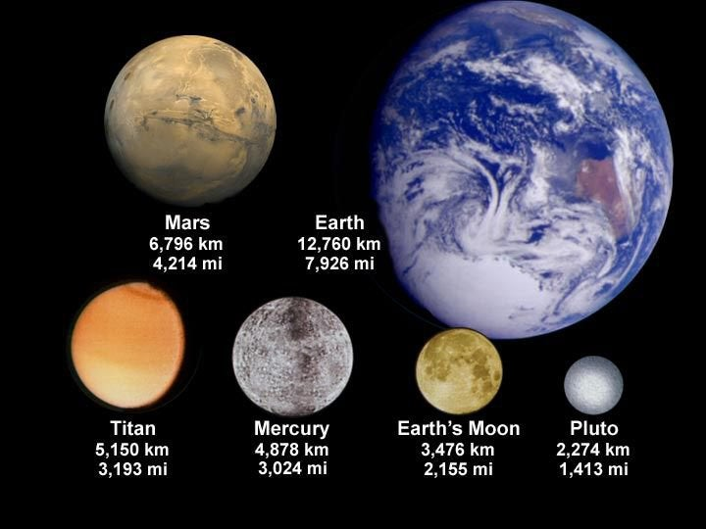
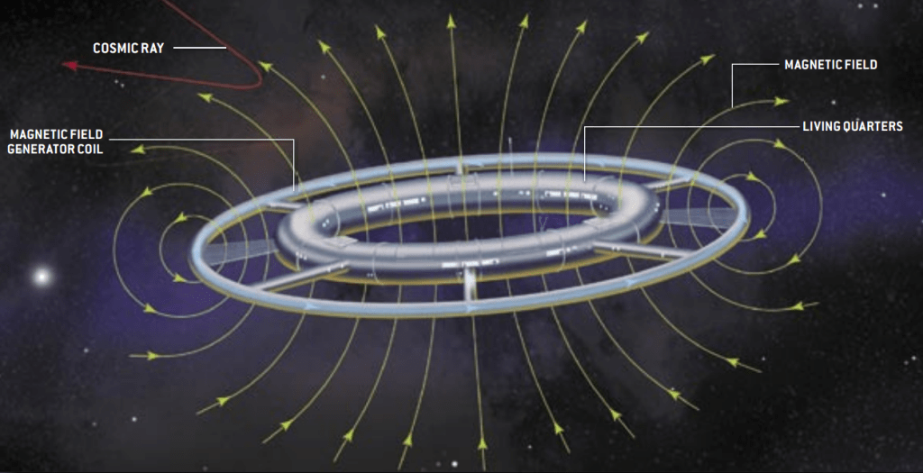
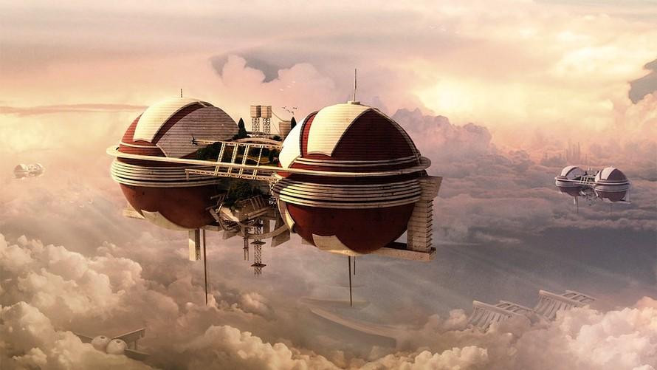
Large scale shielding – atmosphere, magnetic fields
Effects on humans
satellite.taltech.ee
rauno.gordon@taltech.ee

Slide 32
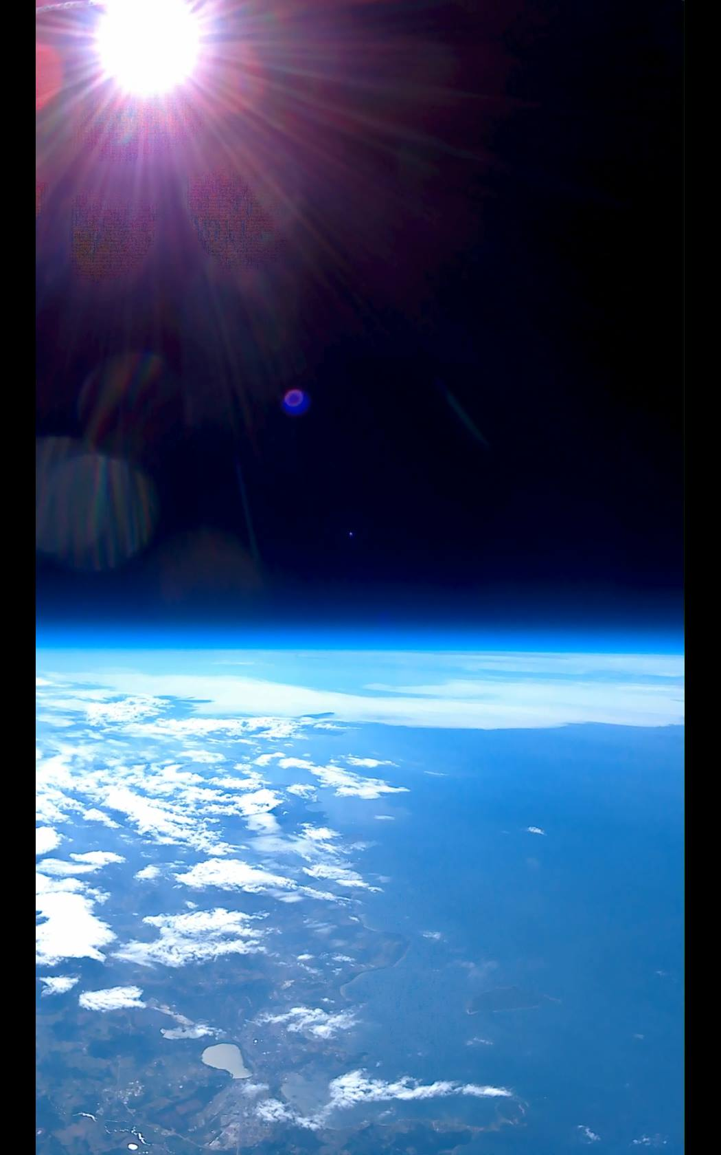
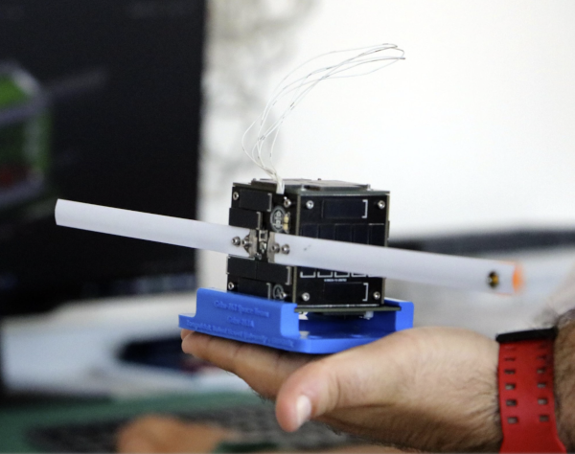
New project 2022: PocketQube
Make a satellite: 5*5*5 cm
Team, project courses, practice, thesis topics
Will fly to orbit in 2025
Experiments in stratosphere
https://www.youtube.com/watch?v=wCH8loS2OgI

Slide 33
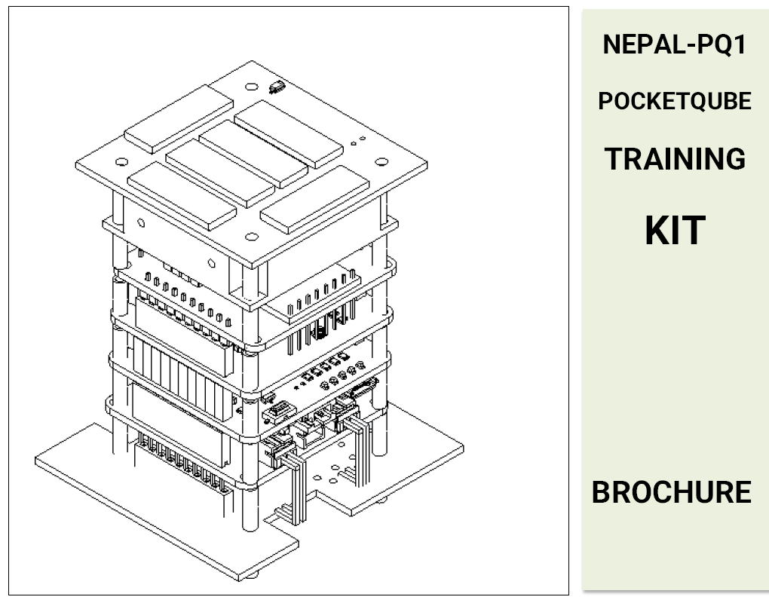
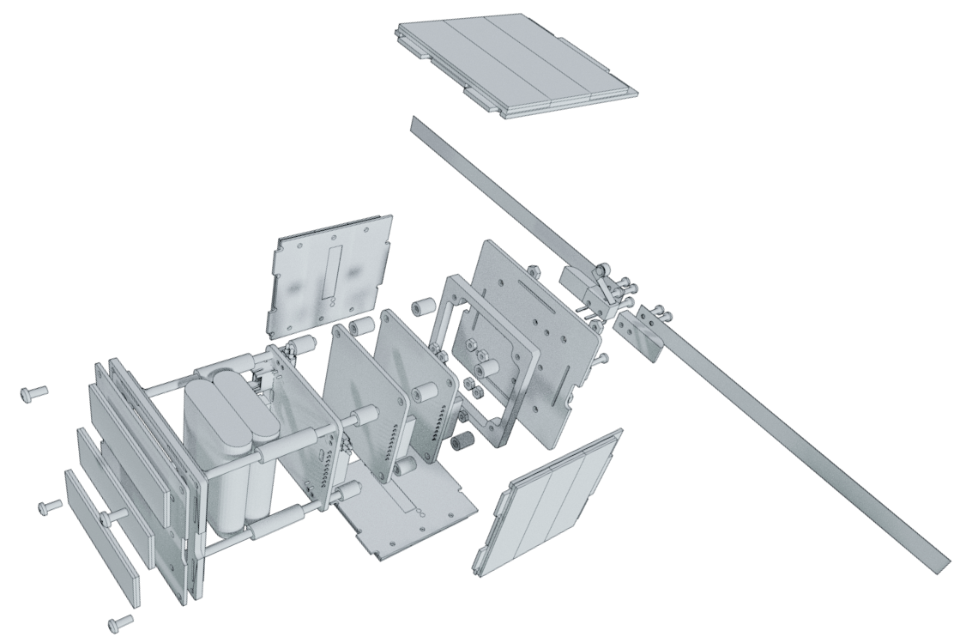
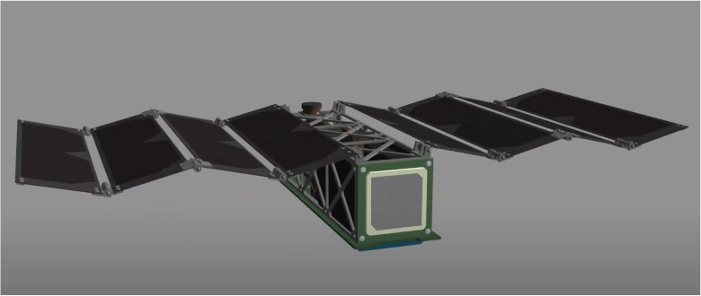
PocketQube
https://orionspace.com.np/
Make a satellite: 5*5*5 cm
Team, project courses, practice, thesis topics
Experiments in stratosphere
Will fly to orbit in 3 years
https://libre.space/projects/qubik/
http://www.albaorbital.com/

Slide 34
PocketQube
Make a satellite: 5*5*5 cm
Team, project courses, practice, thesis topics
Experiments in stratosphere
Will fly to orbit in 3 years
Project timeline:

Slide 35
satellite.taltech.ee
Requirements to get to a rocket – vibration, thermal-vacuum
Space environment – objects, debris, relative speeds
Surface dangers – atomic oxygen
Radiation from the sun – Earth magnetic field, solar activity
Galactic radiation – particles, ions
Shielding – aluminum, water/hydrogen
Dust shielding – lighter + conductive, spreading
Whiskers, conformal coating, cold welding
Large scale shielding – atmosphere, magnetic fields
Effects on humans

Slide 36
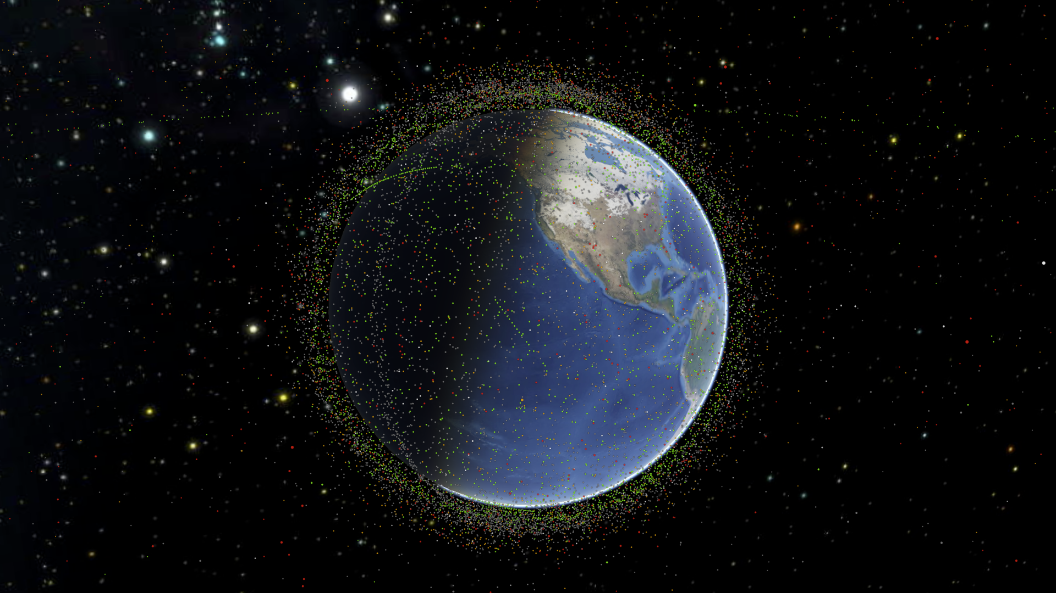
Space danger
Requirements to get to a rocket – vibration, thermal-vacuum
Space environment – objects, debris, relative speeds
Surface dangers – atomic oxygen
Radiation from the sun – Earth magnetic field, solar activity
Galactic radiation – particles, ions
Shielding – aluminum, water/hydrogen
Dust shielding – lighter + conductive, spreading
Whiskers, conformal coating, cold welding
Large scale shielding – atmosphere, magnetic fields
satellite.taltech.ee
rauno.gordon@taltech.ee

