Slide 1
Lecture CM5: INTRODUCTION
Definition and main components of automatization. Introduction to logic control.

Slide 2
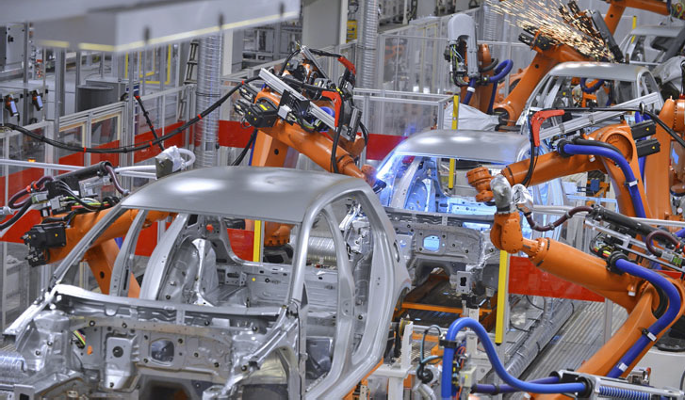
What is automatization?

Slide 3

What is automatization?

Slide 4
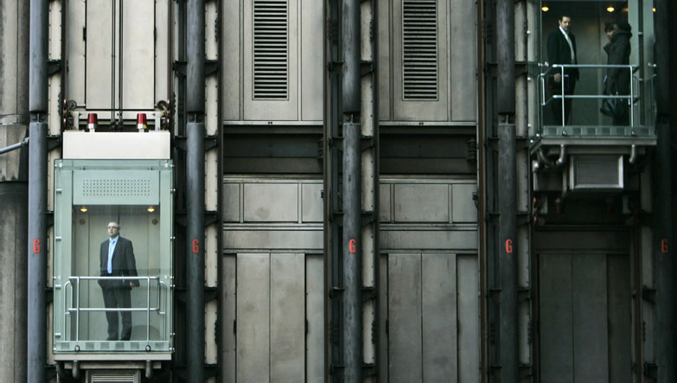
What is automatization?

Slide 5
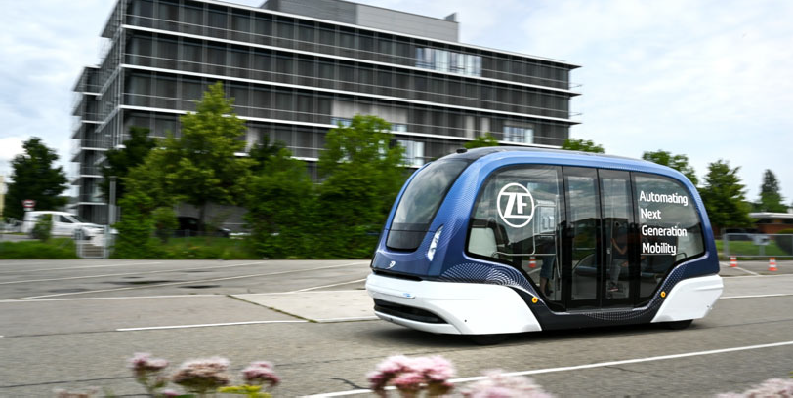
What is automatization?

Slide 6
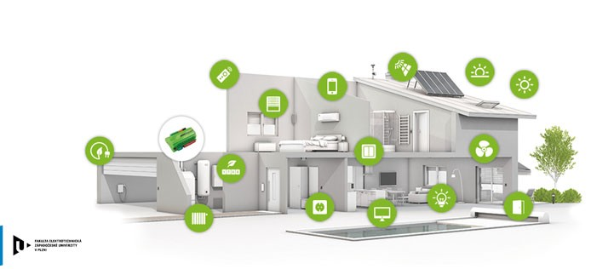
What is automatization?

Slide 7
What is automatization?
Automatization is everywhere
Automated manufacturing processes
Robotics
Electronic control systems
Traffic control
Autonomous vehicles
Smart homes
Communication systems, …

Slide 8
What is automatization?
Automatization is a set of activities consisting of the design and implementation of measures that enables machines to self-control human mental activities associated with starting machines, calculations in controlling of the operating parameters, optimizing the operation of machines, and stopping them.
Automatization is highest level of improvements in manufacturing process
1. level – Instrumentation – the work process is equipped with hand tools
2. level – Mechanization – human labor is replaced by machines
3. level – Automatization – mental and control work is replaced by the activity of machines

Slide 9
Purpose and reasons for automatization
Forced automatization
Immediate presence poses a grave danger to humans (environment with high radiation, temperature, pressure, etc.)
Human involvement is cause of errors, which consequences leads to high losses, even on lives. (automatic plane approach guidance in low visibility)
Human is not able to perform the necessary actions in terms of speed, accuracy, range or other reasons (control of nuclear reactors, control of rockets, etc.)
Automatic control performs task with better quality and accuracy (robot can lead paint gun on complex trajectory with steady speed to achieve high quality uniform layer of paint)
Automatic control has to be used because human cant be present for various reasons (space probes, control of artificial hearth, etc.)

Slide 10
Purpose and reasons for automatization
Economical reasons
Use of automatic control means a reduction in production costs compared to non-automated production
Use of automation equipment represents a reduction of operational costs for storage space, production areas, repairs of machines, consumption of various energies
Use of automation equipment allows to increase the productivity of work and the volume of production, so that we can produce a larger quantity of products for a given time
Other reasons
automation often increases human comfort (automatic garage door control, remote control of devices in home, smart homes)
Automatization allows human to obtain useful informations
Automatization helps to ensure the implementation of the environmental measures (automatic environmental polution monitoring systems, management of optimum combustion to reduce harmful exhaust gases)

Slide 11
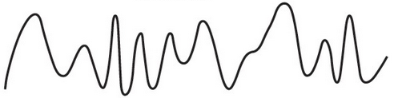

Structure of automatization system
Supervising inputs
Monitoring
Control system
Sensors
Actuators
Process
Actuators performs operations in automated process
Sensors monitors process and gives control information about process state
Control system is brain of automation system
Continuous (analog) control
Discontinuous (digital) control

Slide 12
Basic concepts of switching algebra
Circuit can be divided according to conductivity into:
Conducting
Nonconducting
Switch can be in state:
Switched ON
Switched OFF
Logical variable can take only two values (states):
0 – signal doesn’t exist, statement is false, circuit is not conducting, switch is off, voltage is not present
1 – signal exist, statement is true, circuit is conducting, switch is on, voltage is present

Slide 13
Basic logical operations
Logical function is dependance of one or more output (dependent) variables on one or more input (independent) variables.
Notation
f(x)= x₁+x₂… general notation
x is input variable
f(x), y is output variable
Logical function can be written as:
Algebraic notation
Verbal expression
Block diagram / Ladder diagram
Truth table

Slide 14
Types of logic circuits
Output of Combinatory logic circuit depends only on combination of current values of input(independent) variables and output is single value of output (dependent) variable.
State logic (sequential) circuitry doesn’t depend only on values of input variable, but also on previous state of output variable. State logic circuit contains memory.

Slide 15
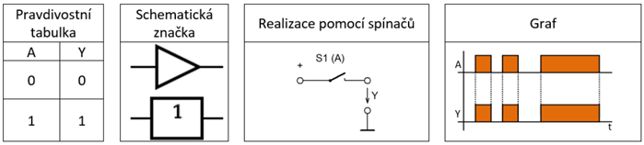

Basic logic functions
YES
Repeater
Output is always same value as input
Can be used as time delay (typically ns)
Algebraic notation: $Y=A$
Truth table
Schematics
Contact logic
Timing diagram

Slide 16
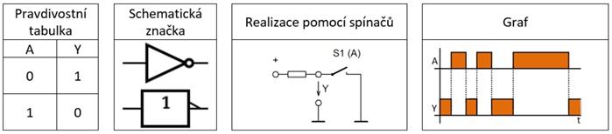

Basic logic functions
NOT
Logical negation
Output has opposite value of input
Algebraic notation: $Y= \overline{A}$
Truth table
Schematics
Contact logic
Timing diagram

Slide 17
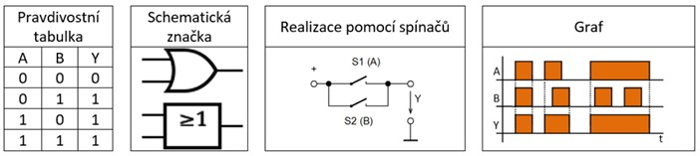

Basic logic functions
OR
Logical sum (disjunction)
Function returns 1 if at least one of the input is 1
Function returns 1 unless both of its inputs are 0
Algebraic notation: $Y=A+B$
Truth table
Schematics
Contact logic
Timing diagram

Slide 18
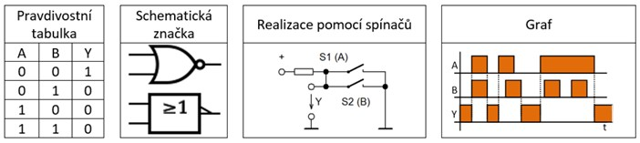

Basic logic functions
NOR
Negated logical sum
Function returns 0 unless all its inputs are 0
Algebraic notation: $Y=\overline{A+B }$
Truth table
Schematics
Contact logic
Timing diagram

Slide 19
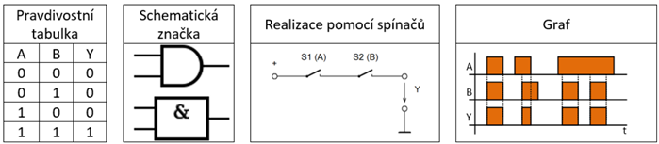

Basic logic functions
AND
Logical multiplication (conjunction)
Function returns 0 unless all its inputs are 1
Algebraic notation: $Y=A∙B$
Truth table
Schematics
Contact logic
Timing diagram

Slide 20
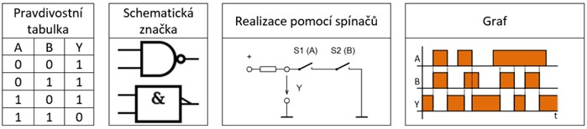

Basic logic functions
NAND
Negated logical multiplication
Function returns 1 unless all its inputs are 1
Algebraic notation: $Y=\overline{A∙B}$
Truth table
Schematics
Contact logic
Timing diagram

Slide 21
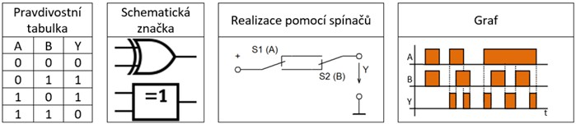

Basic logic functions
XOR
Excusive logical sum (exclusive OR)
Function returns 1 if inputs have different value
Function returns 1 unless all inputs has same value
Algebraic notation: $Y=A ⨁{B}$, $Y=\overline{A}∙B+A∙\overline{B}$
Truth table
Schematics
Contact logic
Timing diagram

Slide 22
Basic logic functions
In circuit notation:
Multiplication is serial connection of components
Summation is parallel connection of components
Logical function can be realized by:
Classical mechanical components – switches, buttons, relays
Electronic components – diodes, transistors, logic circuits
Programable devices
Microcontroller, programable circuit
PLC – Programmable Logical Controller

Slide 23
Notation in electrical circuits
Normally open contact
Normally closed contact
Normally open push button
Normally closed push button
Coil of relay or contactor
Light, signalization

Slide 24
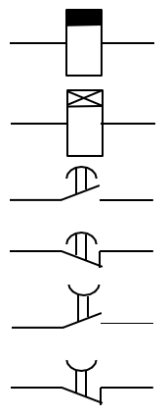
Notation in electrical circuits
Coil of time relay with delayed switch off
Coil of time relay with delayed switch on
Normally open contact with delayed switch on
Normally closed contact with delayed switch on
Normally open contact with delayed switch off
Normally closed contact with delayed switch off

Slide 25
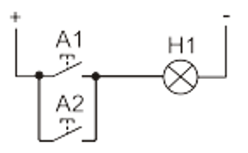
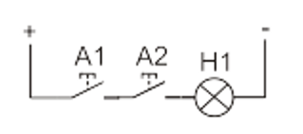
Basic contact logic realization
Logic summation (OR)
Logic multiplication (AND)

Slide 26
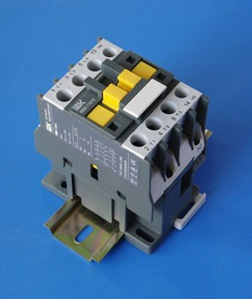
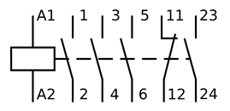
Contactor
Device designed for frequent switching in industrial application.
Low voltage and current on contactor coil can switch on main contacts in high power circuits.
Main contacts (power contacts)
For switching of higher currents and power
Single digit contacts (1,2,3,4,5,6)
Auxiliary contacts (control contacts)
For low power switching in control circuits
Double digit contacts

Slide 27
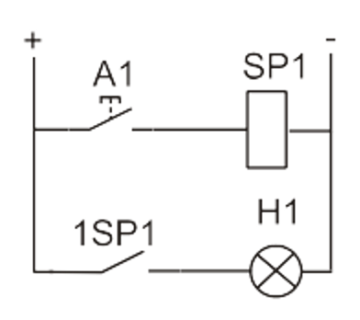
Basic contact logic realization
Basic circuit with start push button and one auxiliary contact
Button will close circuit with coil SP1
With voltage on coil, contact 1SP1 will close and turn on light
When button is no longer held, coil will turn off and contact will open

Slide 28
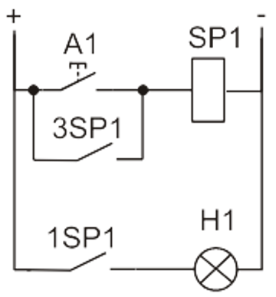
Basic contact logic realization
Circuit with start push button and self holding contact
Button will close circuit with coil SP1
With voltage on coil, contact 3SP1 will close and complete the circuit with coil even if button A1 is no longer pushed

Slide 29
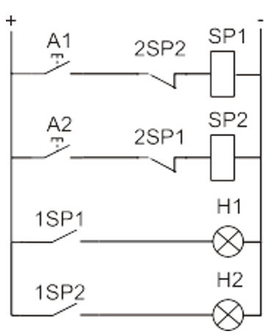
Basic contact logic realization
Circuit with two mutually blocked relays
Button A1 will close circuit with coil SP1
With voltage on coil, contact 2SP1 will open
If button A2 would be pushed while SP1 is still on, circuit would be still open by 2SP1 and SP2 won't turn on
To turn on SP2, SP1 have to be turned off

Slide 30
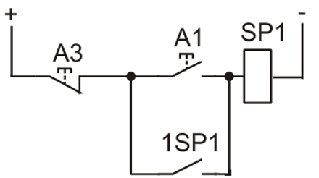
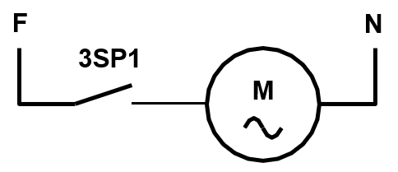
Basic contact logic realization
Circuit for starting of Induction machine (IM) by direct connection to grid
Button A1 will close circuit with coil SP1
Contact 1SP1 will hold coil SP1 switched on
Voltage on coil SP1 will close main contact 3SP1, which will connect stator winding of IM directly to grid.
Pushing of A3 will disconnect coil SP1, and both contact will open, and IM will be disconnected.
Control circuit
Power circuit
L

Slide 31
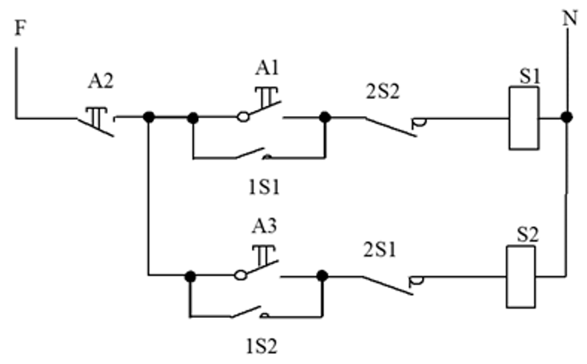
Basic contact logic realization
Circuit for starting of IM to both direction
Control circuit
L
N

Slide 32
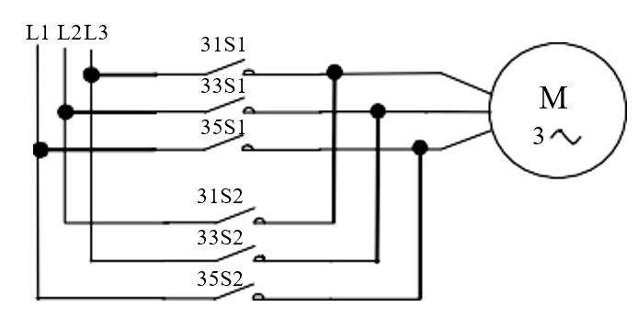
Basic contact logic realization
Circuit for starting of IM to both direction
Power circuit

Slide 33
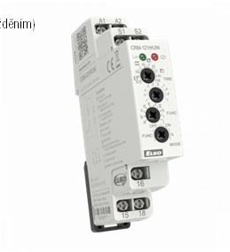
Timing relay
We need differentiate
moment of coil excitation (coil of relay electromagnet is connected to voltage)
moment of switch on/off (Moment when contact change their state. NO contact are closed.)
Timing relay has controllable time delay between:
moment of coil excitation and moment of switching
moment of coil deexcitation and moment of switching

Slide 34
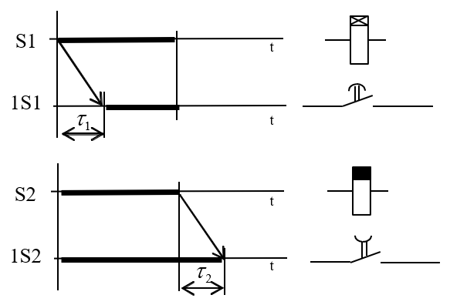
Timing relay
Relay with delayed switch on
Relay with delayed switch off

Slide 35
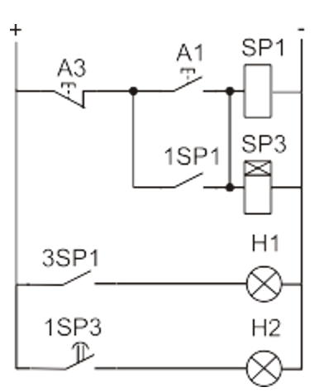
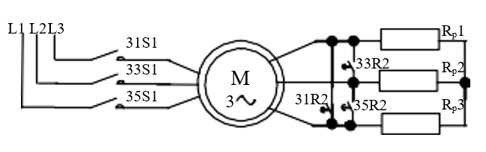
Example of circuit with time relay
Application
Start of doubly fed Induction machine
Start of IM with Y/D change

Slide 36
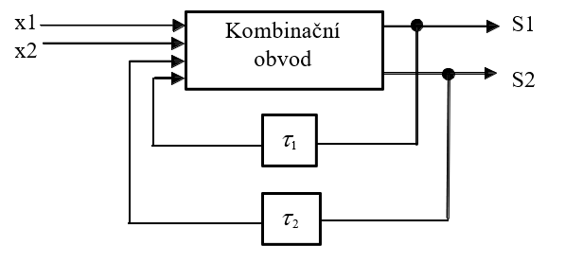
State logic circuit
Output of state logic circuit doesn’t depend only on current value of input signals, but also on previous state
State logic can keep the previous state, while combinatory cant.
It contains of two parts: combinatory part, memory
Value of output depends on previous state in memory
Combinatory circuit

Slide 37
State logic circuit
State logic circuits can be divided to:
Asynchronous – change of input variable immediately affect current state (RS flip-flop circuit)
Synchronous – contains controlling synchronization signal (clock). Change of input will affect current state after synchronization pulse (JK flip-flop)
According to reaction to clock signal, synchronous circuits are:
Triggered by level – circuit monitors values of input variable during whole time of clock impulse and react continuously.
Triggered by edge – circuit react to input variables only during the change of clock signal (ether leading or descending edge of digital signal)

