Slide 1

Learning outcomes and constructive alignment
Margit Ojaots, Taavi Vaikjärv

Slide 2

HAKA E-course quality label
2. The course objectives and learner-centered learning outcomes are formulated.
3. The content of the course supports the achievement of the course learning outcome
6. The learning activities and assessment principles of the course support the achievement of the learning outcomes.

Slide 3
What are learning outcomes?
What is constructive alignment?
Learning outcomes are measurable statements that articulate at the beginning what students should know, be able to do, or value as a result of taking a course or completing a program
Constructive alignment is an approach to curriculum design which is focused on closely aligning teaching and assessment to intended learning outcomes.

Slide 4
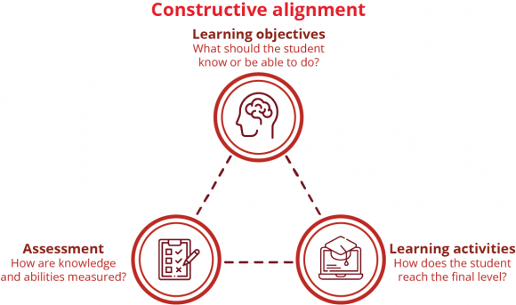
Radboud University https://www.ru.nl/en/staff/lecturers/designing-education/designing-courses/integrating-learning-objectives

Slide 5
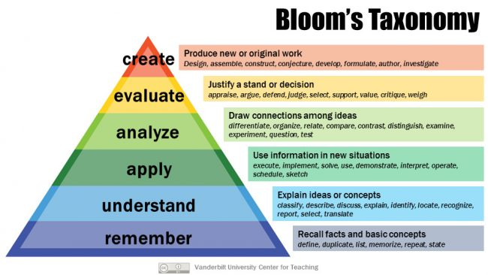
https://cft.vanderbilt.edu/guides-sub-pages/blooms-taxonomy/

