Slide 1

ASSessment
Formulating Good learning outcomes
Margit Ojaots, Taavi Vaikjärv

Slide 2
Things to consider when designing your assessment
Why do you use continuous assessment? Why do you use final assessment?
How much do you use formative/summative assessment?
(When and how do you give feedback?)
What are your evaluation criteria?

Slide 3
§ 20. Methods and scale of assessment of achievement of the learning outcomes
(2) In case of graded assessment, the level of achievement of learning outcomes by a student is assessed based on the following scale:
A (5) – “excellent” – outstanding and particularly profound achievement of learning outcomes, along with creativity and consummate proficiency in applying skills and knowledge;
B (4) – “very good” – very good achievement of learning outcomes, along with proficiency in applying skills and knowledge in a targeted and creative manner. Some details of knowledge and skills my exhibit errors which are neither substantive nor serious;
C (3) – “good” – good achievement of learning outcomes, along with proficiency in applying skills and knowledge in a relevant manner. A certain imprecision and uncertainty are apparent in the depth and detail of knowledge and skills;
D (2) – “satisfactory” – sufficient achievement of learning outcomes, along with application of knowledge and skills in a typical manner; in atypical situations both, uncertainty as well as lack of knowledge and skills are apparent.
E (1) – “poor” – minimum acceptable achievement of the most important learning outcomes along with limited application of knowledge and skills in typical situations; in atypical situations both, considerable uncertainty as well as lack of knowledge and skills are apparent;
F (0) – “failed” – achievement in knowledge and skills below the minimum standard.
§ 20. Methods and scale of assessment of achievement of the learning outcomes
(2) In case of graded assessment, the level of achievement of learning outcomes by a student is assessed based on the following scale:
A (5) – “excellent” – outstanding and particularly profound achievement of learning outcomes, along with creativity and consummate proficiency in applying skills and knowledge;
B (4) – “very good” – very good achievement of learning outcomes, along with proficiency in applying skills and knowledge in a targeted and creative manner. Some details of knowledge and skills my exhibit errors which are neither substantive nor serious;
C (3) – “good” – good achievement of learning outcomes, along with proficiency in applying skills and knowledge in a relevant manner. A certain imprecision and uncertainty are apparent in the depth and detail of knowledge and skills;
D (2) – “satisfactory” – sufficient achievement of learning outcomes, along with application of knowledge and skills in a typical manner; in atypical situations both, uncertainty as well as lack of knowledge and skills are apparent.
E (1) – “poor” – minimum acceptable achievement of the most important learning outcomes along with limited application of knowledge and skills in typical situations; in atypical situations both, considerable uncertainty as well as lack of knowledge and skills are apparent;
F (0) – “failed” – achievement in knowledge and skills below the minimum standard.

Slide 4
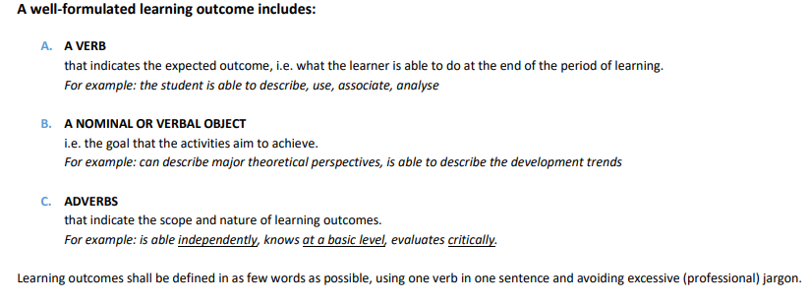
https://upload.ttu.ee/show/file/PPPPBG:77ee2a9262efe31ab3c10e1c98356e11.pdf

Slide 5
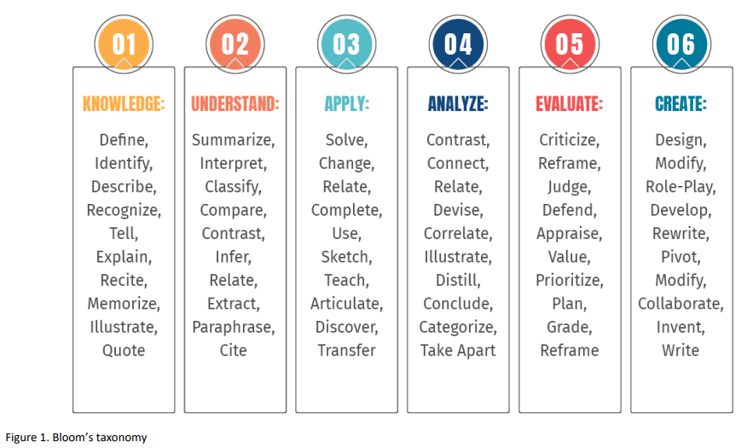

Slide 6
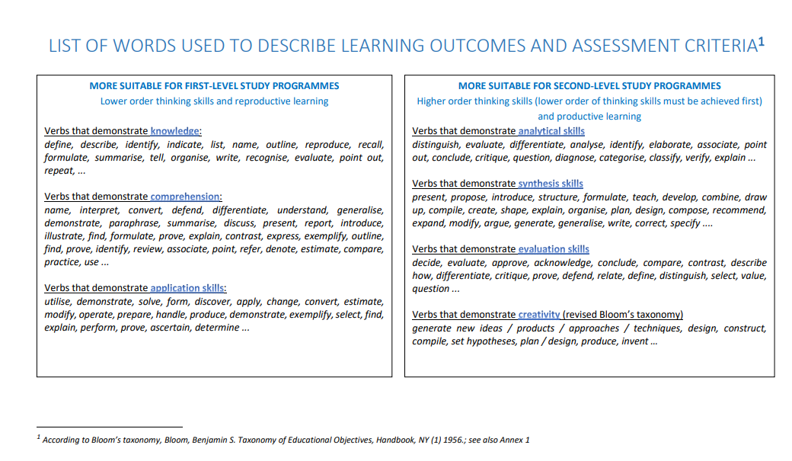

Slide 7
Verbs to avoid
Knows
Is able to
Understands
Its better to use verbs from previous slides that make it clear what kind of learning and assessment activities will be used

