Slide 1

VAY1030 Mathematical Methods of Data Analysis
Practice: python
Lesson 3

Slide 2
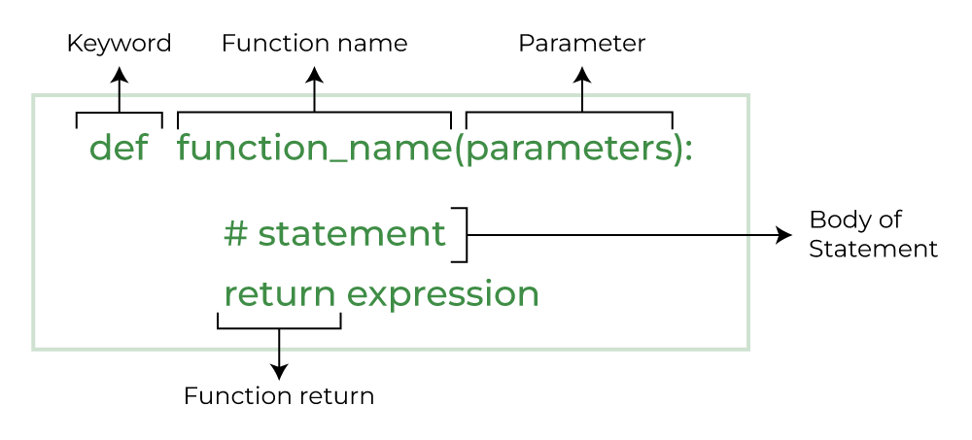
Methods and functions
>>> def say_hi():
... print("howdy hi")
...
>>> say_hi # just checking what it is, doesn't run anything
<function say_hi at 0x7f997d2a8510>
>>> say_hi() # this runs it
howdy hi

Slide 3
Methods and functions
def my_function(fname):
print(fname + " Refsnes")
my_function("Linus")
def my_function(x):
return 5 * x
print(my_function(3))
#default parameter value
def my_function(country = "Norway"):
print("I am from " + country)
my_function("Sweden")
my_function()
def my_function(*kids):​
print("The youngest child is " + kids[2])​
​
my_function("Emil", "Tobias", "Linus") ​
​
def my_function(**kid):​
print("His last name is " + kid["lname"])​
​
my_function(fname = "Tobias", lname = "Refsnes")

Slide 4
Methods and functions
Ask firstname
Ask lastname
Ask users age ( int(input("Age?"))
Printout results
Create function for gettting user data as dict
Ask users data 5 times and store as list
Display all entered users data
# Ask the user to enter their
def greet_user():
# function input() asks input from console
name = input("Please enter your name: ")
name = name.capitalize()
# Print the greeting message with custom name
print(f"Hello, {name}!")
if __name__ == '__main__':
greet_user()

Slide 5
List -> Array -> String -> chars
if __name__ == '__main__':
array: = ['H', 'e', 'l', 'l', 'o', ' ', 's', 't', 'u', 'd', 'e', 'n', 't']
print(array[0] + array[1] + array[2] + array[3] + array[4]) #output 1: Hello
print(array[0:5]) #output 2: ['H', 'e', 'l', 'l', 'o']
What data type is used for variable array ?
Please compare output1 and output2.
What is difference? Why ?
What data type and structure used?

Slide 6
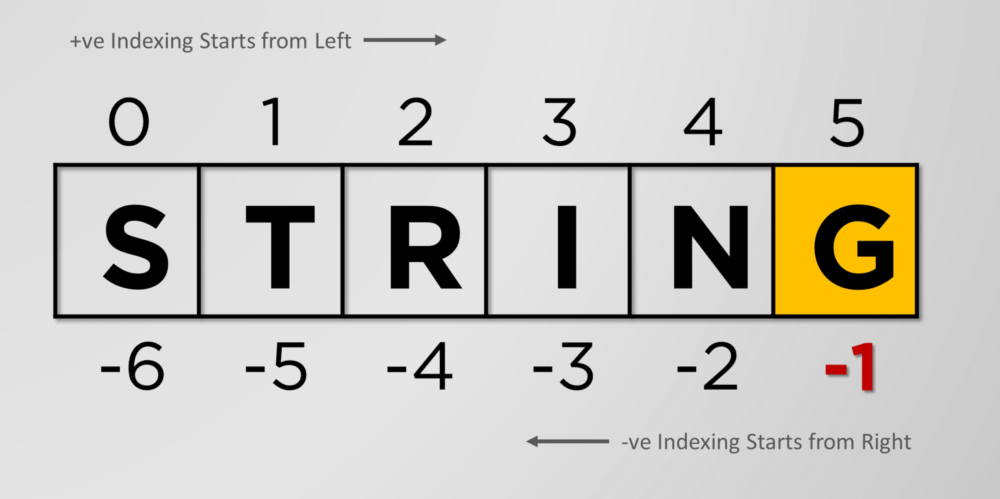
List -> Array -> String -> chars
Quick tutorial with examples: w3school.com/python/strings

Slide 7
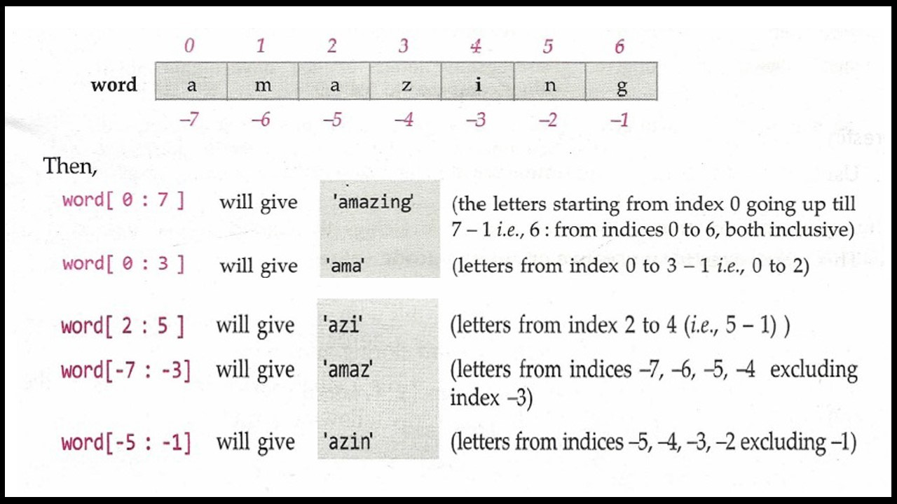
Strings: slicing
if __name__ == '__main__':
word = "amazing"
print(word[-7:-1])
print(word[:])
print(word[-100:-1])
print(word[-100:0]) # ???
How to get substring "ing"?
How to get substring "mazi"?
What will be result of word[-100:-1]?
What will be result of word[0:10]?
What will be result of word[-10:0]?

Slide 8
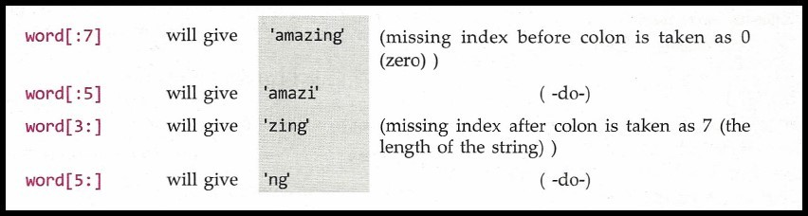
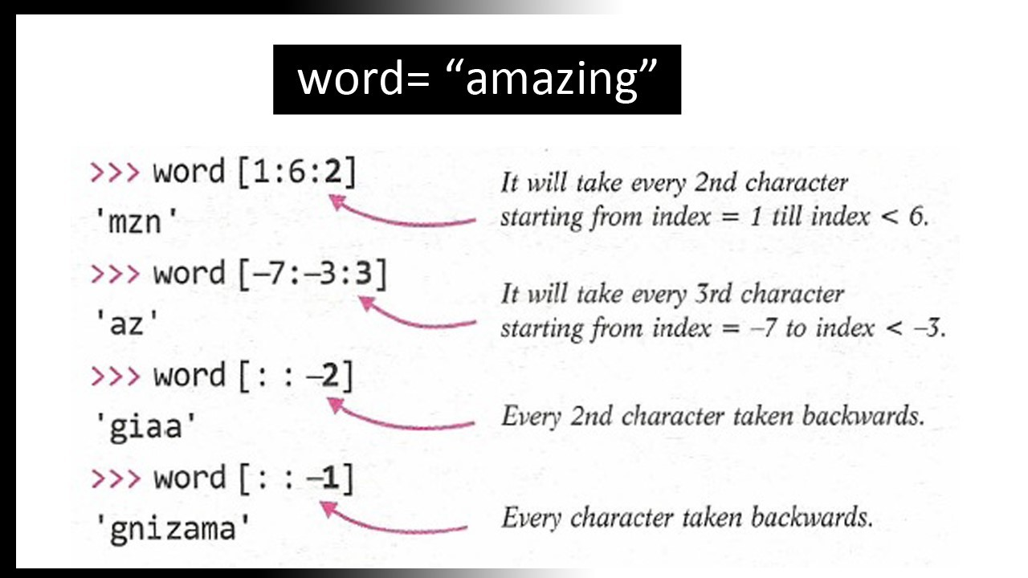
String slicing : bonus

Slide 9
if __name__ == '__main__':
# Maritime-related string (Length between 100 and 200 characters)
maritime_text = """
The vast ocean is the lifeblood of global trade, with ships navigating the seas, transporting goods across continents. Mariners brave the unpredictable waters, relying on advanced navigational instruments, weather forecasting, and their own skill to ensure the safety of both vessel and crew.
"""
# Example: Getting a substring by index
start_index = 10 # Starting index for the substring
end_index = 80 # Ending index for the substring
# Extract the substring using Python slicing
substring = maritime_text[start_index:end_index]
# Print the full text and the extracted substring
print("Full Maritime Text:")
print(maritime_text)
print("Extracted Substring (from index 10 to 80):")
print(substring)
Test is text contains some phrase from variable word
Show surounding text +/- 10 symbols before and after phrase

Slide 10
Working with string
Official docs: https://docs.python.org
>>> ' hello 123 '.strip() # strip from both sides​
'hello 123'​
>>> our_string.ljust(30, '-')​
'Hello World!------------------'​
>>> our_string.rjust(30, '-')​
'------------------Hello World!'​
>>> our_string.center(30, '-')​
'---------Hello World!---------'​
>>> our_string.count('o') # it contains two o's​
2​
>>> our_string.index('o') # the first o is our_string[4]​
4​
>>> '-'.join(['hello', 'world', 'test'])​
'hello-world-test'​
>>> 'hello-world-test'.split('-')​
['hello', 'world', 'test']​
>>> our_string.upper()
'HELLO WORLD!'
>>> our_string.lower()
'hello world!'
>>> our_string.startswith('Hello')
True
>>> our_string.endswith('World!')
True
>>> our_string.endswith('world!') # Python is case-sensitive!!!
False
>>> our_string.replace('World', 'there')
'Hello there!'
>>> our_string.replace('o', '@', 1) # only replace one o by @
'Hell@ World!'

Slide 11
String formatting
>>> f"My name is {name} and I'm on the {channel} channel on {network}."
"My name is Akuli and I'm on the ##learnpython channel on freenode."
>>> 'Three zeros and number one: {:04d}'.format(1)
'Three zeros and number one: 0001'
>>> 'Three zeros and number one: %04d' % 1
'Three zeros and number one: 0001'
>>> 'Rounded Pi: %.2f' % 3.1415
'Rounded Pi: 3.14'
pi: float = 3.141592653589793
print(f"This is pi {pi:0.2f}")

Slide 12
if __name__ == '__main__':
animals = {
'Lion': {'name': 'Leo', 'sex': 'Male', 'alias': 'King of the Jungle'},
'Tiger': {'name': 'Tara', 'sex': 'Female', 'alias': 'The Striped Hunter'},
'Elephant': {'name': 'Ella', 'sex': 'Female', 'alias': 'Mighty Trunk'},
'Penguin': {'name': 'Penny', 'sex': 'Female', 'alias': 'The Waddler'},
'Kangaroo': {'name': 'Kenny', 'sex': 'Male', 'alias': 'Jumping Jack'},
'Dolphin': {'name': 'Danny', 'sex': 'Male', 'alias': 'The Flipper'},
'Zebra': {'name': 'Zara', 'sex': 'Female', 'alias': 'The Striped Wonder'},
'Giraffe': {'name': 'Gigi', 'sex': 'Female', 'alias': 'Tall and Graceful'},
'Bear': {'name': 'Benny', 'sex': 'Male', 'alias': 'The Grizzly'},
'Monkey': {'name': 'Milo', 'sex': 'Male', 'alias': 'The Playful Primate'}
}
# Sort the animals dictionary by the animal name (key)
sorted_animals = sorted(animals.items())
# Print the header
print(f"{'Animal':<12} {'Name':<10} {'Sex':<6} {'Alias':<20}")
print("-" * 50)
# Print the sorted rows
for animal, details in sorted_animals:
print(f"{animal:<12} {details['name']:<10} {details['sex']:<6} {details['alias']:<20}")
# Print the sorted rows
for animal, details in sorted_animals:
if details['sex'] == 'Male': # Check if the animal is male
print(f"{animal:<12} {details['name']:<10} {details['sex']:<6} {details['alias']:<20}")
Please print out animals whos names are ending with "nny"

Slide 13
String: individual work 1 (grading)
Print out students names from names in capitals
Show each student grade next to student name, use formatting (.ljust() .rjust()) to aligh columns
Some students missed exam, please print "--.--" instead of score
Add pass/failed column next to score, to pass exam score should be more than 50
We have list of students and exam grades:
if __name__ == '__main__':
names: list[str] = [
"Alice", "Bob", "Charlie", "David", "Eva", "Frank", "Grace", "Hannah", "Ivy",
"Jack", "Katherine", "Liam", "Megan", "Nathan", "Olivia", "Georg", "Mike"
]
exam_results: dict[str, float] = {
"Alice": 85.5, "Bob": 92.3, "Charlie": 68.9, "David": 88.4, "Eva": 91.2,
"Frank": 14, "Grace": 95.1, "Hannah": 43.8, "Ivy": 89.6, "Jack": 80.2,
"Katherine": 90, "Liam": 86.7, "Megan": 57.3, "Nathan": 93.5, "Olivia": 91.8,
"Vera": 92.7, "Walter": 76.5, "Xander": 85.3, "Yvonne": 77.9, "Zane": 89.0
}

